Slide 1

We Need to Keep “Those Kids” in School!
“The Pyramid Scheme”
Dan Sackheim
Educational Options Consultant
Educational Options Office

Slide 2
Focus Question:
Is this a school you would want to attend?
…and that wants you to attend?

Slide 3
Every student needs and deserves…
… an educational placement that is, at least, adequately matched to their learning and developmental abilities, needs and styles.
Notes:
3

Slide 4
Our guiding question:
What do we need to do to enable this student to engage successfully in school?

Slide 5
Asset Development Based
  Academic Development
  Social Development
  Emotional Development
We are comprehensive education!

Slide 6
Local Control and Accountability Plan
Priorities
The LCAP must include a description of annual goals to be achieved for state priorities and any local priorities must be identified.
State Priorities
Pupil Engagement
(attendance rates, chronic absenteeism rates, dropout rates, graduation rates)
Basic Services
Other Pupil Outcomes
Implementation of Common Core State Standards
Parental Involvement
Course
Access
Pupil Achievement
School Climate
(suspension and expulsion rates)

Slide 7
Student’s Place on this Continuum
“Foundation” – This student’s community context, including social and economic positive and challenging conditions.

Slide 8



Do what we say, or you will be subject to punishment and/or expulsion from our lands!!!!!

Slide 9
One Size Does Not Fit All!
Solutions
What works for one student, school, or district may not be appropriate or effective for another.
Notes:
9

Slide 10
Educational Options…
… provide a supportive environment with specialized curriculum, instruction, guidance and counseling, psychological services, and tutorial assistance to help students overcome barriers to learning.
Notes:
10

Slide 11










See each student as an individual!
Notes:
11

Slide 12



Educational Options Support
At-Risk/At-Promise Youth
Notes:
12
12

Slide 13
It’s about students learning and developing.
It’s about teachers
teaching.
It’s about the district and school administration providing leadership and support(ers).

Slide 14
Focus Question:
How are we going to hurt kids
by (not) doing this?
?

Slide 15
The 3 Rs
Relationships
Relevance
Resiliency

Slide 16
Resiliency
► the ability to persist in the face of challenge

Slide 17
Are we supporting or undermining students’ resiliency?

Slide 18
Findings of Resilience Research
Risk ≠ Outcome
Behavior ≠ Capacity
Personal Strengths = Success
Environmental Supports
& Opportunities = Life Success

Slide 19


Who Drops Out?
Risk Factors for Dropping Out
Socioeconomic status
Ethnicity
Repetition of a grade
Student mobility
Family situation
Notes:
19

Slide 20
Drop Aways

Slide 21
We need to ask:
What are they dropping away from?

Slide 22

ATTENDANCE
Cultural Competence and Disparities/Disproportionality
ABSENCES
Dropout Rates
(Mental) Health
Behavioral Interventions and Supports
Equity
Graduation Rates
School Climate
Barriers
Access

Slide 23
Attendance
Attendance
Absence
Absence

Slide 24
Definition of
“Chronic Absentee”
What is a chronic absentee?
EC Section 60901(c)(1):
A “chronic absentee” is a pupil who is absent on 10 percent or more of the school days in the school year when the total number of days the pupil is enrolled and school was actually taught in the regular day schools of the district, exclusive of Saturdays and Sundays.

Slide 25
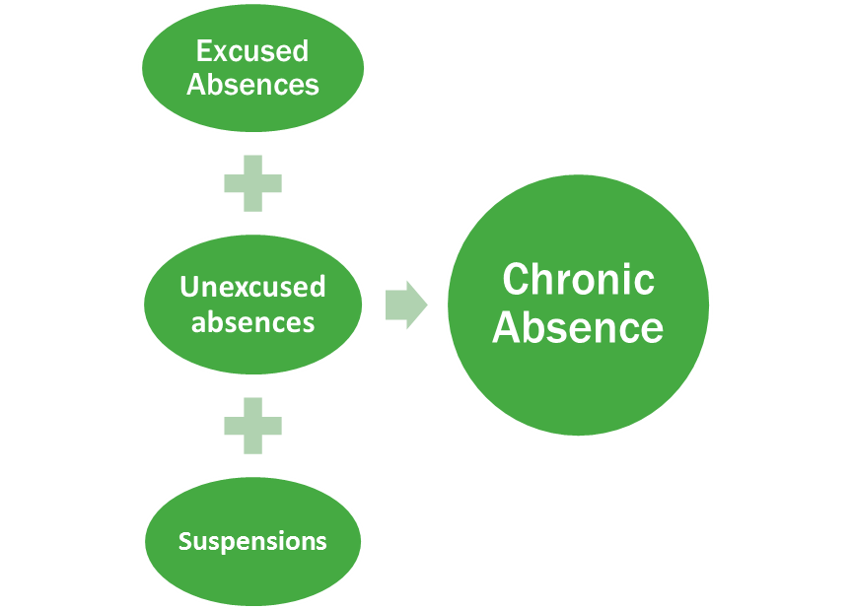
The Value of Chronic Absence Data
Compared to Truancy Data
Truancy

Slide 26
Ask:
Why isn’t this student in school today?
What is this student absent from?
Where is this student instead of in class?

Slide 27
Barriers to Attendance
School climate
Bullying
Excessive suspensions instead of restorative/rehabilitative approaches
Chronic health conditions (such as asthma, diabetes, dental, or mental health issues)
Homelessness
Domestic violence
Sexual exploitation
Parental neglect
Pregnant and parenting / child care (for own kids or siblings)
Drug or alcohol abuse
Transportation issues
Curriculum and teaching methods

Slide 28
Futures at Risk:
Absence as an Early Indicator
Students who are chronically absent in kindergarten and first grade:
Are much less likely to be proficient readers.
Only 12 percent of students who are
chronically absent in kindergarten and
first grade read proficiently in third grade.
Have higher levels of suspension and
lower academic achievement in middle school
Chronic absence in sixth grade is the most predictive indicator that a student will not graduate from high school.
(Attendance Works)

Slide 29
Early Identification System
Create an early warning system to monitor student attendance closely and frequently.
Within schools, continuously collect, monitor and analyze data about absences
Look for patterns in the identified subgroups to determine the most effective interventions. For example, is a schoolwide intervention needed—or does your school need case management of individual chronic absentees?
Law enforcement/courts/social services agencies should triage and collaborate with schools.

Slide 30
We Need to Address
Misunderstandings and Reset Baselines
Example of a Misunderstanding
How We Can Address
“My child can easily make up for a missed day by completing a homework packet or makeup assignment.”
“There are some things learned in school that can’t be made up at home.”
“The other students need your child to help contribute to their learning.”
Current Baseline
How We Can Address
“Most of my child’s classmates are absent at least as much as my child (10+ days).”
“Missing just 2 days per month puts your child on track to having far more absences than average.”

Slide 31
Intervention/Transfer Recommendation Form
What is right about this student?
What are her/his strengths?
What is s/he interested in?
Where is s/he successful?
What are her/his needs?
What are her/his challenges?

Slide 32
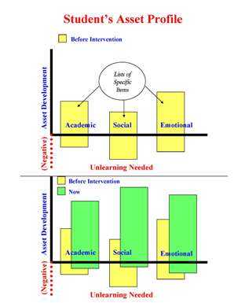

Slide 33
Asset-Based Referral Forms
Referral forms, recommending that a student be transferred to a community day school (CDS), sometimes are limited to statements about what the student has done wrong. As referral forms evolve from exit tickets and increase in depth and quality, the following elements are added:
Descriptions of interventions done to/for the student.
Descriptions of modifications to the programs.
Reframing “problems and deficits” as “challenges” and “issues of concern”
Requiring completion of sections describing the student’s assets and strengths, in addition to (and separate from) challenges.
Breaking assets/challenges into academic, social, and emotional areas.
Ask what the student is interested in / good at doing.
Do you use a Student STUDY Team (to study the problem) or a Student SUCCESS Team (to enable success)? The difference goes beyond semantics.

Slide 34
Infusing Social-Emotional Curriculum vs Extra Time

Slide 35



Character-Based Curriculum
Literature with themes about social, emotional and ethical development – and issues the students are already thinking about

Slide 36
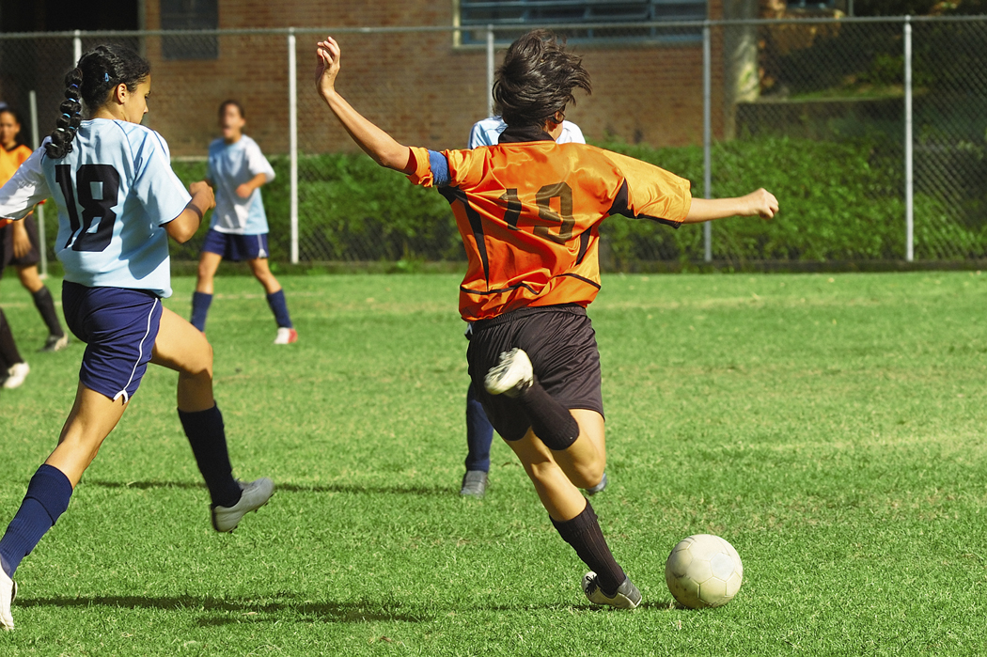

Soccer and basketball are all about where everyone else is and where they are going.

Slide 37
Dad’s Question:
What have you done today
to make the world better
for someone who isn’t you?
Notes:
37

Slide 38
First, ask the student
what is wrong.
Then, LISTEN TO HER!

Slide 39

Listen Through
Their Ears!
Language – Concerns – Message – Context – Assets – Worries – Challenges – Future
Notes:
39
39
39
Their:
Language
Concerns
Message
Context
Assets
Worries
Challenges
Future

Slide 40
Ask: Could there be a mental health or other wellness issue here?
Could this behavior come from some past trauma?
?

Slide 41
“I don’t get it.”
Notes:
41

Slide 42
“Teacher, please explain/show
that to me
a different way.”
Notes:
42

Slide 43
Behavioral Interventions
How do we successfully cross over the challenge of creating a safe and supportive learning environment?

Slide 44





Keep kids in?
Or push them out?
EXIT
Notes:
44
Are we using Positive Behavioral Intervention Supports, or are our actions towards youth counterproductive?

Slide 45
1st draft…2nd draft…3rd draft…
In academics, and in behavior, the student’s effort we just observed can be improved the next time, and improved again...
We need to notice and support this improvement.

Slide 46
NOT
YET

Slide 47
School-to-Career
Being a student develops
essential job skills!

Slide 48
Zero Tolerance
Two Definitions:
Must punish/suspend/expel
Must intervene
Notes:
48

Slide 49
Zero tolerance commits us to intervention to support the successful development of the student
―not punishment.

Slide 50
Automatic
Interventions
Appropriate

Slide 51
Other Means of Correction
Ed Code Section 48900.5
(a) Suspension, including supervised suspension as described in Section 48911.1, shall be imposed only when other means of correction fail to bring about proper conduct. A school district may document the other means of correction used and place that documentation in the pupil’s record, which may be accessed pursuant to Section 49069. However, a pupil, including an individual with exceptional needs, as defined in Section 56026, may be suspended, subject to Section 1415 of Title 20 of the United States Code, for any of the reasons enumerated in Section 48900 upon a first offense, if the principal or superintendent of schools determines that the pupil violated subdivision (a), (b), (c), (d), or (e) of Section 48900 or that the pupil’s presence causes a danger to persons.

Slide 52
48900.5(b) Other means of correction include, but are not limited to:
(1) A conference between school personnel, the pupil’s parent or guardian, and the pupil.
(2) Referrals to the school counselor, psychologist, social worker, child welfare attendance personnel, or other school support service personnel for case management and counseling.
(3) Study teams, guidance teams, resource panel teams, or other intervention-related teams that assess the behavior, and develop and implement individualized plans to address the behavior in partnership with the pupil and his or her parents.
(4) Referral for a comprehensive psychosocial or psychoeducational assessment, including for purposes of creating an individualized education program, or a plan.

Slide 53
48900.5(b) Other means of correction include, but are not limited to:
(5) Enrollment in a program for teaching prosocial behavior or anger management.
(6) Participation in a restorative justice program.
(7) A positive behavior support approach with tiered interventions that occur during the schoolday on campus.
(8) After-school programs that address specific behavioral issues or expose pupils to positive activities and behaviors, including, but not limited to, those operated in collaboration with local parent and community groups.

Slide 54

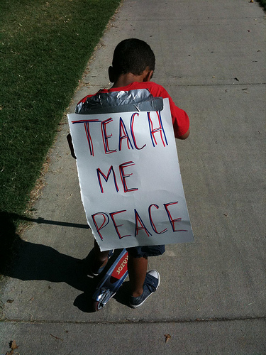
Respond as an educator!
Hunker down with a troubled student and teach!

Slide 55
Mission Statement blah blah blah blah blah blah blah blah blah blah blah blah blah PUNISH blah blah blah blah blah blah blah blah blah blah CASTIGATE blah blah blah blah blah blah blah blah blah REBUKE blah blah blah blah blah blah blah blah blah blah blah blah blah REPRIMAND blah blah blah blah blah blah blah blah CHASTISE blah blah blah blah blah blah blah blah blah blah blah blah blah blah blah blah blah blah blah blah PENALIZE blah blah

Slide 56

Hold on!
Time out
Regroup!
Take five
Chill!

Slide 57
What are we suspending when we tell a student that s/he is not allowed to come to school?
  Academic learning (new and reinforcement)
  Connection to school community
  Safety from outside environment
  Access to the student for us to use our professional skills to help him (un)learn behaviors, as appropriate

Slide 58
Students might infer that either whatever is taught has so little value that missing lessons is not considered a serious problem, or that their own learning is not highly valued by school.
Blah blah blah blah blah blah blah blah …

Slide 59
Suspension Can Be Counterproductive
Worried about gangs? Send students out of school and into the streets.
Concerned about quality of home life as part of the cause of the problem? Send students home to dysfunctional adults.

Slide 60

Externalizing the Problem
The Person is Not the Problem, the Problem is the Problem
Student is Recognized as Inherently “Good”
Student’s Behavior was “Not Good”
How can the Community Support the Student in Aligning their Behavior with their True Self ?

Slide 61
Traditional Approach | Restorative Approach
School rules are broken. | People and relationships and harmed.
Justice focuses on establishing guilt. | Justice identifies needs and responsibility.
Accountability = punishment. | Accountability = understanding impact and repairing harm.
Justice directed at the offender; the victim is ignored. | Offender, victim, and school all have direct roles in the justice process.
Rules and intent outweigh whether outcome is positive or negative. | Offender is responsible for harmful behavior, repairing harm, and working towards positive outcomes.
Limited opportunity for expressing remorse or making amends. | Opportunity given to make amends and express remorse.

Slide 62
Externalizing the Problem
YOU
ME
THE PROBLEM

Slide 63
THE PROBLEM
Real Needs and Valid Goals

Slide 64




Look me in the eye when I talk to you!

Slide 65
Two students enter the classroom before the bell.
One is black or brown, the other is white.
They are loud and their motions are very large.
The teacher suspended both students and sent them to the office. She sent a note to the vice-principal suggesting that the black/brown student might be a gang member and that the white student might have ADHD.
The teacher needs to recognize that the students came to class - and on time.
The teacher needs to recognize culturally supported behaviors – and understand about code switching.
The students need to recognize that the same behavior can be situationally appropriate or inappropriate.
The students needs to understand about the impact of a storm before the calm.

Slide 66
Exit Contract Page 1
Name of Student Date
Name of Referring School Contact information
Name of Receiving School (and type of school)
Date of transition
Person who will greet student on first day
Primary staff contact for student for monitoring and support
Schedule of follow-up meetings and list of anticipated participants

Slide 67
Exit Contract Page 2
Individual Learning Plan including: Student’s Assets: Academic, Social and Emotional Learning/unlearning challenges that remain and strategies and responsible individuals to address those challenges
Outline the specific counseling and other support services the student will receive.
How will the intervention educators serve as a resource for the next school?
What mechanisms are provided to support family during the transition period?
What specific plans are already in place to support a student to successfully get through and beyond any trouble time in the post-intervention placement?

Slide 68
School Attendance (and Behavior)
Review
Boards

Slide 69
Roles of Local School Attendance Review Boards
Enforce compulsory education laws
Develop coordinated services between school, community, and home to address attendance and behavior issues
Recommend solutions for school attendance/behavior issues to families that have exhausted school resources
Refer families that do not comply with the prescribed directives for legal recourse

Slide 70
We have so much to do
to teach to the standards.
How do we fit this in?

Slide 71

Positive School Climate
=
More Teachable Time

Slide 72

Passion
Passive

Slide 73

Improved Behavior and Attendance:
You can make it happen!
Photo by Max Flanery
Courtesy of California Geological Survey

Slide 74

How wonderful it is
that nobody need wait
a single moment
before starting to improve the world.
- Anne Frank

Slide 75
Thank you!
Dan Sackheim
Education Programs Consultant
Educational Options Office
California Department of Education
(916) 445-5595
dsackheim@cde.ca.gov

