Slide 1
restorative practices & student attendance
ATTENDANCE
IMPROVEMENT
COLLABORATIVE
DAVID KOPPERUD
Retired state sarb chair,
Cascwa state board member
Amir Alavi m.a., j.d.
A I C FOUNDER
Cell: (858) 722-9992
attendanceic@gmail.com

Slide 2
INTRODUCTIONS
Please put in the chat box:
Your name
The district you are from
Your position
Your favorite food

Slide 3
OBJECTIVE
To review some principles of Restorative Practices (RP) and to explore how we can integrate RP into our work with attendance and the SARB process.

Slide 4
TODAY’S AGENDA
The Crisis of Chronic Absenteeism
John Doe – a Composite Hypothetical
MTSS Concepts
Restorative Practices (RP) Principles Applied to Attendance
Trauma, RP & Discipline
John Doe “Take 2” & Conclusion
This is NOT an RP Certification Training

Slide 5
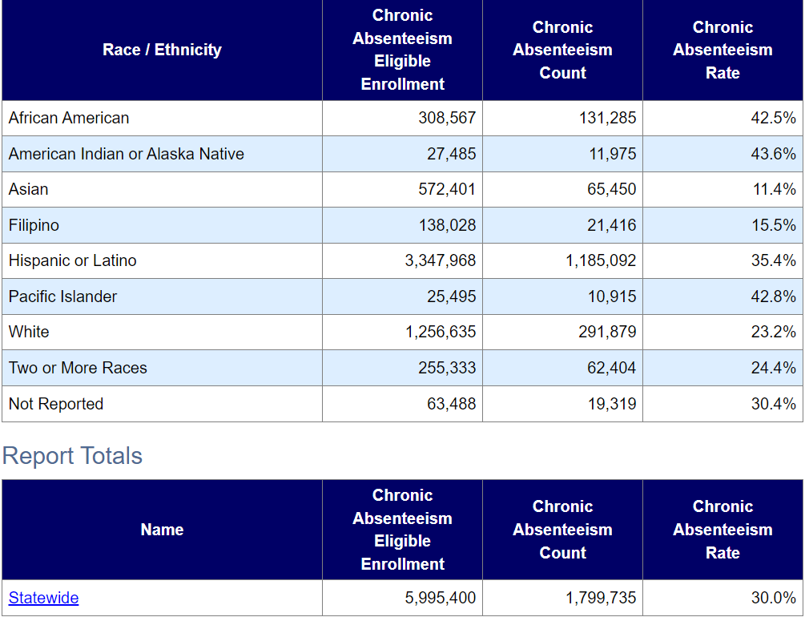
ATTENDANCE STATS - DATAQUEST
CA 2021 – 2022 Chronic Absenteeism
https://dq.cde.ca.gov/dataquest/DQCensus/AttAbsByRsn.aspx?agglevel=State&cds=00&year=2020-21

Slide 6
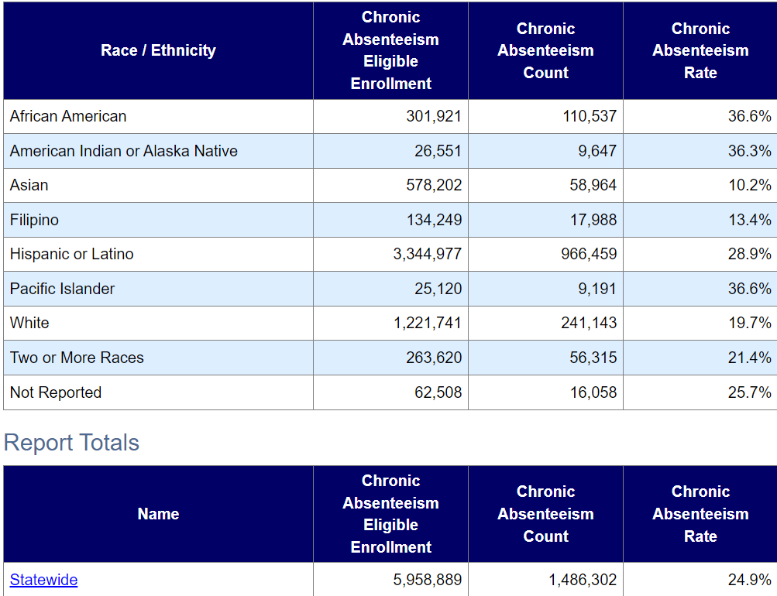
ATTENDANCE STATS - DATAQUEST
CA 2022 – 2023 Chronic Absenteeism
https://dq.cde.ca.gov/dataquest/DQCensus/AttAbsByRsn.aspx?agglevel=State&cds=00&year=2020-21

Slide 7
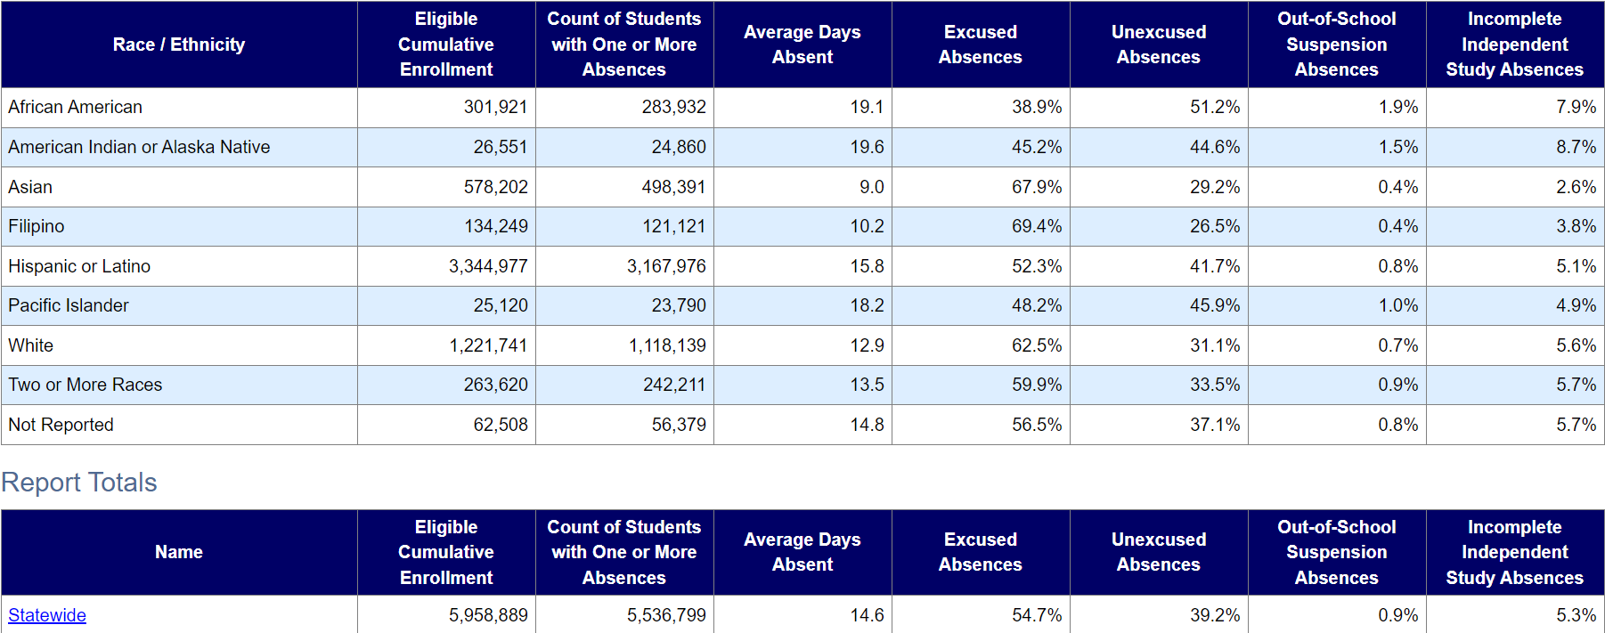
ATTENDANCE STATS - DATAQUEST
CA 2022 – 2023 Absenteeism by Reason

Slide 8
“John Doe”: Take 1 – Pre Covid-19
John is a 7th grade student who loves to play the guitar his uncle gave him. He is a bright young man, but he is angry.
John grew up in an abusive household where he and his mother were victims of ongoing physical and verbal abuse.
John’s mother, now single, raises 3 kids on her own and commutes to a neighboring county for work, often leaving home at 5 a.m.
John’s older sister Jane is supposed to make sure John attends school, but mom and sis have a hard time w/ John’s defiance.
John acts out in class when he is there, curses the teacher and has been suspended 3 times in the past. John has 18 full day truancies by December. He has been diagnosed w/ ADD.

Slide 9
“John Doe”: Take 1
The school site sends out Notifications of truancy with such language:
“This is a serious violation of the law! Your student is missing critical instruction and you are liable. Pursuant to CA Education Code 48293, the courts can impose fines and fees and you are subject to criminal prosecution under CA Penal Code 270.1.”
The site holds a SART meeting and mother cannot attend because she is working that morning in a neighboring county. The case is referred to district SARB without a 2nd attempt.
Mother attends the SARB meeting but is angry and frustrated. The SARB panel starts off immediately with content and numbers and the meeting degenerates into argument. One panelist says to mom, “this is your 3rd year in a row, what kind of parent are you?”
The SARB offers: “Saturday School”, access to the online portal, & health tech to excuse absences in lieu of a Dr. Note. There is no follow up.

Slide 10
“John Doe”: Take 1
OUTCOME?

Slide 11
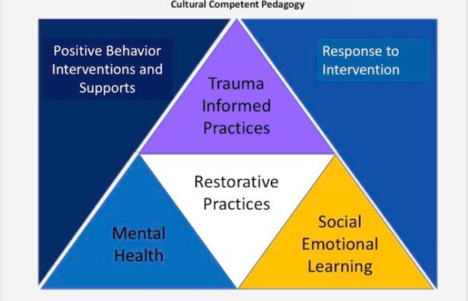
MTSS CONCEPTS
http://culvercitycrossroads.com/2019/12/10/ccusd-school-board-workshop-multi-tiered-systems-of-support

Slide 12
A POWERFUL FRAMEWORK

Slide 13
WHAT IS RESTORATIVE PRACTICES?
https://www.youtube.com/watch?v=_obyZY4XzaI

Slide 14
RESTORATIVE PRACTICES PRINCIPLES
PURPOSE OF RESTORATIVE PRACTICES:
"The aim of restorative practices is to develop community and to manage conflict and tensions by repairing harm and building relationships.“
SOURCE: https://www.iirp.edu/what-we-do/defining-restorative
SO:
BUILDING & DEVELOPING COMMUNITY
REPAIRING HARM / DAMAGE
BUILDING / RESTORING RELATIONSHIPS!

Slide 15
SARB PRINCIPLES
To build community & to foster positive relationships
To reintegrate & restore student to good attendance & standing
To repair the damage of absenteeism
THE SARB PROCESS IS RESTORATIVE!!

Slide 16
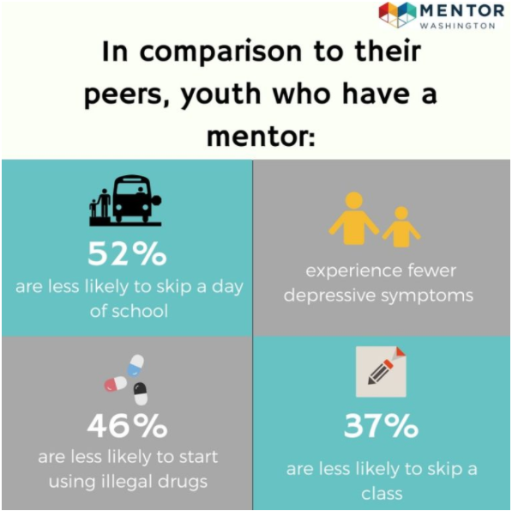
BUILDING COMMUNITY – TIER I
MENTORING
Relationship Skills
Communication Skills
Higher Attendance
Expanded Career Interests
https://www.mentorwashington.org/why-mentor/mentoring-impact/
RCOE – in house mentoring model

Slide 17
BUILDING COMMUNITY – TIER I
Student Engagement
Parent Involvement / Family Engagement
School Climate
COMMUNICATIONS & TONE
Positive Messaging
Letters
Phone Calls, Emails, Texts
Meetings
Home Visits

Slide 18
RESTORATIVE PRACTICES PRINCIPLES
CONNECTION BEFORE CONTENT
The Violin Player – an illustration of connection
Recall: John Doe also plays an instrument
John Doe – an illustration of disconnection
CONNECTION – Merriam-Webster
“a relation of personal intimacy (as family ties)”
DISCONNECTION – “the state of being isolated or detached”
The Role of SHAME…

Slide 19
RESTORATIVE PRACTICES PRINCIPLES
CONNECTION BEFORE CONTENT
Introducing Participants = The Starting Point!
WHAT ELSE?:
CONNECTING WITH THE STUDENT
Welcome! “So Glad To See You!; How Are You Today?”
State One Thing You Really Like About Student
Ask: “What’s One Thing You Really Like?”
To Do? About Yourself?
CONNECTING WITH THE PARENTS
Welcome! “Thank You For Your Time!”
How Are You Today?
Question: How Can We Establish Personal Connection?

Slide 20
GROUP CHAT
WHAT TYPE OF COMMUNICATIONS & TONE HAS YOUR SCHOOL DISTRICT / SCHOOL SITE USED IN THE PAST?
HOW CAN YOUR SCHOOL DISTRICT / SCHOOL SITE REVISE COMMUNICATIONS & TONE TO CREATE STRONGER RELATIONSHIPS & A STRONGER SENSE OF COMMUNITY?

Slide 21
TWO PARADIGMS
Drive by Shooting Student Cursing Teacher (John Doe)
Argument → Stabbing Student Missing School (John Doe)

Slide 22
ATTENDANCE APPROACHES
Punitive | Restorative
Focus on what happened, establish team, dispense punishment. | Focus on understanding outlooks, needs, and responsibilities of all impacted and explore ways to bring remedy.
Focused on making harmful behaviors stop by using increasingly restrictive and/or exclusionary consequences. | Focused on understanding the root causes of misbehavior and offer support for positive changes in behavior.
Accountability defined in terms of receiving punishment. | Accountability defined as understanding the impact of actions, taking responsibility of choices, and finding ways to remedy and prevent future detriment.
Imposed punitive consequences have the effect of shaming and stigmatizing students who have caused harm. | Restorative processes offer an opportunity for students who have caused harm to understand the source of their behavior, take responsibility for their choices, and learn and grow from the experience.

Slide 23
SEPARATING THE DEED FROM THE DOER
“The person is not the problem.
The problem is the problem.”
– Michael White
Particularly True for Attendance
Chronic Absence and poor attendance are symptoms of underlying problems/barriers/issues/obstacles

Slide 24
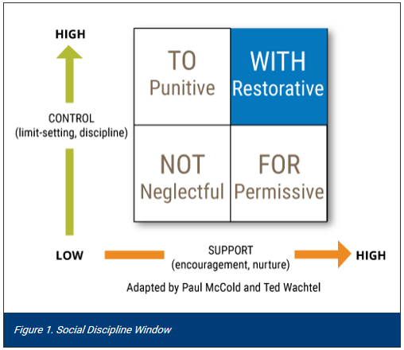
RESTORATIVE PRACTICES PRINCIPLES
THE SOCIAL DISCIPLINE WINDOW:
SOURCE: https://www.iirp.edu/what-we-do/defining-restorative

Slide 25
RESTORATIVE PRACTICES PRINCIPLES
THE SOCIAL DISCIPLINE WINDOW:
SOURCE: https://www.iirp.edu/what-we-do/defining-restorative
Australian criminologist John Braithwaite: “reliance on punishment as a social regulator is problematic because it shames and stigmatizes wrongdoers, pushes them into a negative societal subculture and fails to change their behavior (Glaser, 1964; Braithwaite, 1989).
“The restorative approach, on the other hand, reintegrates wrongdoers back into their community and reduces the likelihood that they will reoffend.”
Braithwaite, J. (1989). Crime, shame and reintegration. New York, NY: Cambridge University Press.
Glaser, D. (1964). The effectiveness of a prison and parole system. Indianapolis, IN: Bobbs-Merrill.

Slide 26
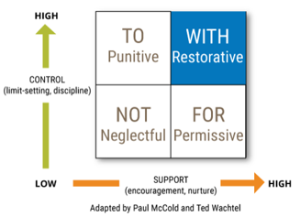
SDW ACTIVITY - Classroom
What box would you be operating in if you said to a student/young person?
Sit down and be quiet.
You really only have to do it if you want to.
I don’t care what you do, sort it out yourself!
You are aware of the expectations in this class. How can I support you in reaching them?
Stephan McPeace – RP Instructor RCOE

Slide 27
SDW ACTIVITY – SART Meeting
What box would you be operating in if you said to a student/parent at a SART or SARB Meeting?
If you don’t get your kids to school, you will be prosecuted and go to jail!
If you have a hard time getting up in the morning, we can ask the attendance clerk to give you a wake-up call.
I don’t care if you get her to school; it’s your child’s future.
You are aware of the importance of regular attendance. How can we work together as partners to get your kids to school?

Slide 28
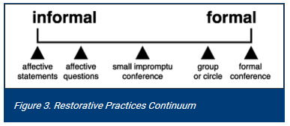
RESTORATIVE PRACTICES PRINCIPLES
RESTORATIVE PRACTICES CONTINUUM
SOURCE: https://www.iirp.edu/what-we-do/defining-restorative
AS WE MOVE TO THE RIGHT, THE PROCESS REQUIRES:
MORE TRAINING
MORE SUPPORT
MORE TIME

Slide 29
“AFFECTIVE STATEMENTS” SOURCE: https://www.iirp.edu/what-we-do/defining-restorative
The IDEA: Communicate Feelings & Impact
“…informal restorative practices include affective statements, which communicate people’s feelings, as well as affective questions, which cause people to reflect on how their behavior has affected others.” (McCold & Wachtel, 2001). [Emphasis Added]
EXAMPLE:
“When you called me _____, I felt hurt and very sad.”
“When you missed class, I felt _______.”
“When your daughter doesn’t _____ , our concern is ________.”

Slide 30
“AFFECTIVE QUESTIONS” SOURCE: https://www.iirp.edu/what-we-do/defining-restorative
The IDEA: “affective questions … cause people to reflect on how their behavior has affected others.” (McCold & Wachtel, 2001).
“In answering such questions, instead of simply being punished, the student has a chance to think about his or her behavior, make amends and change the behavior in the future.” (Morrison, 2003). [Emphasis Added]
SOURCE: Morrison, B. (2003). Regulating safe school communities: Being responsive and restorative. Journal of Educational Administration, 41(6), 689-704.

Slide 31
“AFFECTIVE QUESTIONS”
“AFFECTIVE QUESTIONS”
SOURCE: https://www.iirp.edu/what-we-do/defining-restorative
EXAMPLES:
“When You Missed Class, How Do You Think You Were Affected?”
“When You Missed Class, How Do You Think Others Were Affected?”
“When You Miss School, What Effect Does That Have On Your _____?”
NOTE: Students Respond to Impact on Others / Family!

Slide 32
Modified Questions from RP - Student
Responding to Challenging Behavior & Attendance:
What Happened To Lead You To Miss School?
What Was Your Thought Process (what was going on with you) At The Time?
What Have You Thought About Since?
Who Has Been Affected By You Missing School?
In What Way?
What Do You Think You Need To Improve Your Attendance?
What Can We Do Together To Improve Your Attendance?

Slide 33
Modified Questions from RP - Parent
Responding to Challenging Behavior & Attendance:
What Happened To Lead ____ To Miss School?
What Was Your Thought Process (what was going on with you) At The Time?
What Have You Thought About Since?
Who Has Been Affected By ____ Missing School?
In What Way?
What Do You Think You Need To Improve Attendance?
What Can We Do Together To Improve Your ___’s Attendance?

Slide 34
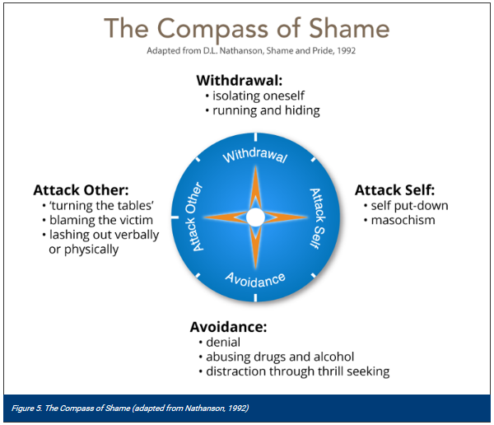
RESTORATIVE PRACTICES PRINCIPLES
“THE COMPASS OF SHAME”
SOURCE: https://www.iirp.edu/what-we-do/defining-restorative

Slide 35
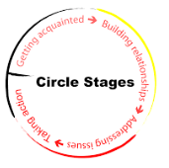
RP RESTORATIVE CIRCLES

Slide 36
RP RESTORATIVE CIRCLES
80% Proactive
Circles in classrooms, impromptu circles for attendance issues w/ groups of students
20% Reactive
Circles in Attendance Meetings
VS.
Proactive Circles Video (next slide)
“Circles for Change – Restorative Practices”
https://www.youtube.com/watch?v=DzbDJBXjVlU

Slide 37
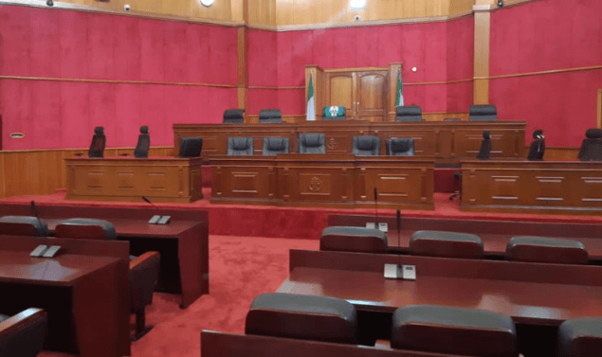
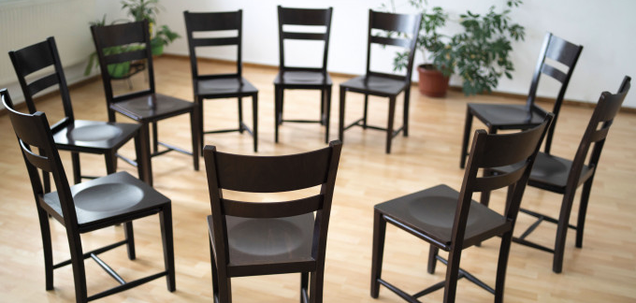
GROUP SHARE
Please describe how you feel in these seating arrangements

Slide 38
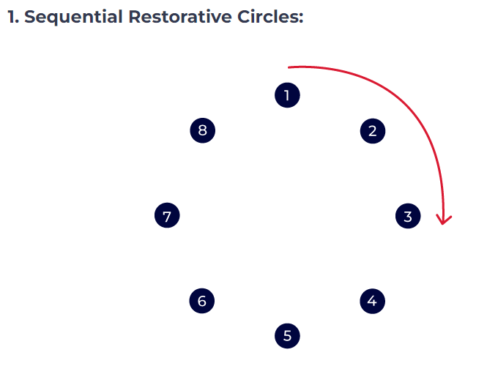
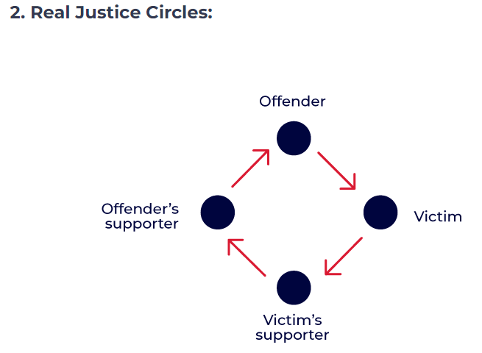
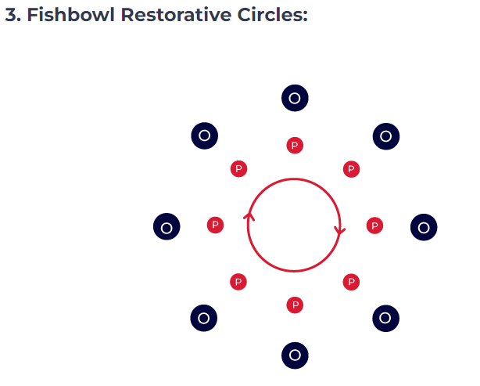
TYPES OF CIRCLES
https://blog.esc13.net/3-types-of-restorative-circles/#:~:text=The%20general%20format%20most%20people,more%20open%20model%20of%20discussion.

Slide 39
RP RESTORATIVE CIRCLES

Slide 40
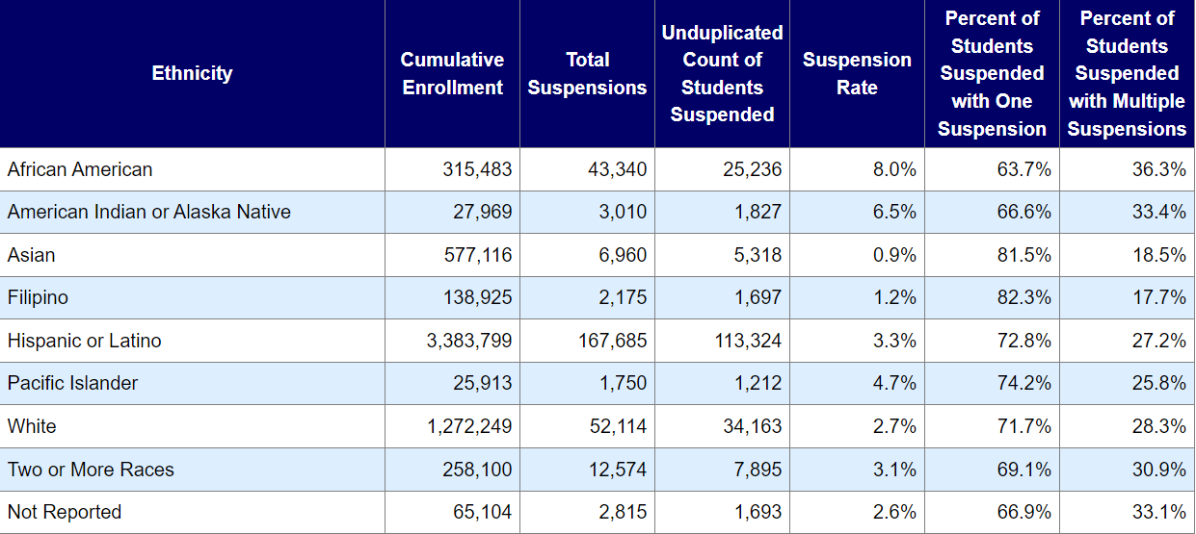
TRAUMA, RP, & DISCIPLINE
2021 – 2022 CA Suspension Rate - DATAQUEST

Slide 41
ACES

Slide 42
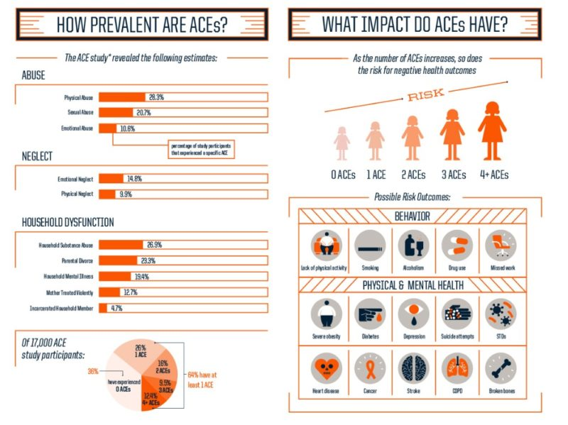
ACES

Slide 43
The Impact of Trauma

Slide 44
The Impact of Trauma

Slide 45
A RESTORATIVE APPROACH TO DISCIPLINE
SULLIVAN HIGH SCHOOL – Chicago Illinois
https://www.youtube.com/watch?v=5r1yvyP141U

Slide 46
“John Doe”: Take 2
John is a 7th grade student who loves to play the guitar his uncle gave him. He is a bright young man, but he is angry.
John grew up in an abusive household where he and his mother were victims of ongoing physical and verbal abuse.
John’s mother, now single, raises 3 kids on her own and commutes to a neighboring county for work, often leaving home at 5 a.m.
John’s older sister Jane is supposed to make sure John attends school, but mom and sis have a hard time w/ John’s defiance.
John acts out in class when he is there, curses the teacher and has 18 full day truancies by December. He has been diagnosed w/ ADD.

Slide 47
“John Doe”: Take 2
The School Site sends an attendance letter that includes:
We want to create a partnership with you to make sure <Student’s Name(s)> attends school. Your support in this process is critical!”
School Site has a dedicated attendance team:
Principal, Nurse, Counselor, Attendance Clerk, PBIS Coordinator
Team builds strong Tier 1 systems of engagement and climate
Student is referred to SART, parent cannot attend
Hold other meetings → Do a home visit & offer services & follow up!

Slide 48
“John Doe”: Take 2
Family is referred to SARB
SARB Personally Serves Notice OR call, email, text, HV…
Mom attends meeting
Tables arranged in a Circle
Introduction & Connection before Content
The mother who was in the E.R. the night before example
Affective Statements & Questions
Commitment to forming a team. Building Relationships!
SART / SARB explores each obstacle & provides resources for each
WHAT SERVICES WOULD THEY OFFER John Doe?
Follow up w/ family
FOLLOW UP, FOLLOW UP,…. UNTIL ATTENDANCE IMPROVES

Slide 49
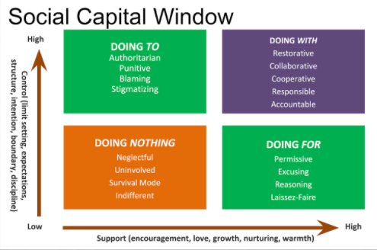
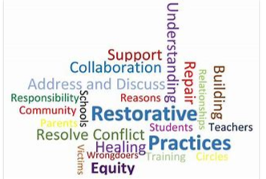
RP – A POWERFUL FRAMEWORK
BUILDING COMMUNITY & STRONG RELATIONSHIPS
HOW DO WE RE-INTEGRATE STUDENTS?
Relationships & Services / Supports / Interventions = The Cure
https://jemmuldoon.blogspot.com/2018/10/the-social-capital-window-of.html

Slide 50
RESOURCES
What is Restorative Practices? https://www.iirp.edu/restorative-practices/what-is-restorative-practices
SDCOE - https://www.sdcoe.net/student-services/system-of-supports/Pages/Restorative-Practices-in-SART-or-SARB-.aspx
Attendance Works: https://www.attendanceworks.org/resources/transition-guide/the-3-es-restorative-practices-to-ground-transition-planning/
Akoben: (Dr. Malik Muhammad)
https://akobenllc.org/

Slide 51
RESOURCES
Affective Statements, Affective Questions, & RP Questions
https://www.restorativeresources.org/uploads/5/6/1/4/56143033/affective_statements_practice.pdf
https://www.spokaneschools.org/cms/lib/WA50000187/Centricity/Domain/176/Restorative%20Communication%20Handout.pdf
https://www.iirp.edu/restorative-practices/defining-restorative/
https://www.teachingwithteachers.com/restorative-practice#:~:text=Affective%20questions%3A%20Accepting%20that%20conflict%20is%20an%20integral,consequences%20and%20separating%20the%20deed%20from%20the%20doer
http://www.joebrummer.com/2015/04/24/making-affective-statements-more-effective-in-restorative-practices/

Slide 52
RESOURCES
Attendanceworks.org
https://www.attendanceworks.org/resources/handouts-for-families/
https://www.attendanceworks.org/resources/toolkits/mentoring-elementary-success-mentors/what-support-is-needed-from-schools/a-principal-led-team-overseeing-attendance/
https://www.attendanceworks.org/wp-content/uploads/2019/06/Attendance-Team-Overview_030220.pdf
https://www.cde.ca.gov/

Slide 53
RESOURCES
http://www.attendanceworks.org/research/portraits-of-change/
Attendance Playbook – Covid-19
https://www.future-ed.org/wp-content/uploads/2020/07/REPORT_Attendance-Playbook-Covid-Edition.pdf
Absenteeism & Truancy: Interventions and Universal Procedures Paperback – 2013, Ph.D William Jenson, Ph.D Randy Sprick , M.S Jessica Sprick
School Leader’s Guide to Tackling Attendance Challenges Paperback – 2018, Ph.D Randy Sprick , M.S Jessica Sprick

Slide 54
restorative practices & student attendance QUESTIONS or COMMENTS?
Amir Alavi m.a., j.d. DAVID KOPPERUD
A I C FOUNDER Retired state sarb chair
Cell: (858) 722-9992 cascwa state board member
attendanceic@gmail.com

