Slide 1
Phil Kauble TopicAL forum
Southern Section
Re-Supporting Student Behavior
February 4, 2022

Slide 2
WELCOME!
Meeting Norms
Click on links in the Chat Box to access materials
Google Folder: https://drive.google.com/file/d/1ZO2JxgOK12uyJfu_Qq1k2KA5b30mB6UX/view?usp=sharing

Slide 3
TODAY’s Agenda
SESSION #1 – 8:40 am
~Ron Wenkart & Alefia Mithaiwala~
Educational Attorneys with Atkinson, Andelson, Loya, Ruud & Romo
SESSION #2 – 9:25 am
Deputy Daniel Lopez
San Bernardino County Sheriff’s Department – Rancho Cucamonga Station
Richard Randolph – Colton Police Officer
SESSION #3 - Expert Panel Members – 10:20 am
Moderator: Leslie Hansen–Director of Student Services in Anaheim Elementary SD
Dr. Katarina Roy Schanz – Director of Wellness & Engagement, Riverside USD
Yvette Magana– Coordinator of CWA for Anaheim Elementary School District
Monique Yessian – Director of Student Services, Tustin Unified School District

Slide 4
OBJECTIVE
Reflect on current challenges to recognize the changes necessary for future success.
Re-envisioning supports for students through Re-supporting Student Behavior.

Slide 5
Southern Section
Membership
MEMBERSHIP LINK
http://cascwa.wildapricot.org/To-Join

Slide 6
California Laws Relating to Minors (2022 Edition)
One-time 20% discount code
S4DISC0331
Review available selections and order publications from:
https://legalbooksdistributing.com/ or
http://s4edconsultants.org/resources.html
Notes:
Discount can be applied to all S4 publications – not just the Red Book.

Slide 7
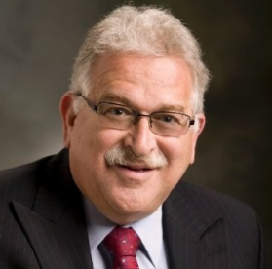
SESSION #1
~Ron Wenkart & Alefia Mithaiwala~
Educational Attorneys with Atkinson, Andelson, Loya, Ruud & Romo
Ron wenkart
Alefia mithaiwala

Slide 8
CASCWA Virtual Conference
First Amendment Rights and
School Discipline
Ronald D. Wenkart, Partner
Alefia Mithaiwala, Partner
February 4, 2022

Slide 9
First Amendment Rights of Students
In the landmark decision of Tinker v. Des Moines Independent Community School District, the United States Supreme Court held that students “do not shed their constitutional right to freedom of speech or expression at the schoolhouse gate.”
The Supreme Court held that students had a First Amendment right to freedom of speech in the school setting so long as the speech did not disrupt the educational process or invade the rights of others.

Slide 10
First Amendment Rights of Students
In Tinker, several students wore black armbands to their school to protest the war in Vietnam in violation of school policy.
The students were suspended from school until they were willing to return to school without their armbands.
The Supreme Court held that the wearing of armbands was akin to “pure speech” that is protected by the First Amendment.

Slide 11
First Amendment Rights of Students
The Court ruled that the wearing of armbands did not involve aggressive or disruptive action.
The Court found no evidence that the wearing of armbands interfered with the school’s work or the rights of other students to be secure and left alone.
In Bethel School District v. Fraser, the Supreme Court upheld the suspension of a student delivering a speech before a high school assembly in which the student employed a graphic and explicit sexual metaphor.

Slide 12
First Amendment Rights of Students
The Court held that the school district may impose discipline upon a student in response to the student’s offensively lewd and indecent speech.
The Court held that it is the role of the school to prepare students for citizenship and to include habits and manners of civility in the curriculum.
The Court noted that the rights of students in the public schools are not automatically coextensive with the rights of adults in other settings.

Slide 13
First Amendment Rights of Students
The U.S. Supreme Court recently issued a ruling on whether students may be disciplined for off-campus conduct.
In Mahanoy Area School District v. B.L., the Supreme Court ruled that off-campus speech may be subject to school discipline depending on the circumstances.
The Supreme Court held that off-campus speech enjoys greater protection under the First Amendment than on-campus speech.

Slide 14
First Amendment Rights of Students
The Supreme Court states that off-campus speech normally falls within the zone of parental responsibility, that political or religious speech enjoys greater protection when uttered outside of school, and unpopular student opinions are entitled to protection as well because “public schools are the nurseries of democracy.”
In Mahanoy, the student was upset that she did not make the varsity cheerleading squad.

Slide 15
First Amendment Rights of Students
The student expressed her frustration on Snapchat one weekend by posting a photo with her middle finger and f___ school, f_____ softball, f____ cheerleading, and f____ everything.
About 250 students saw the post and several conversations took place at school discussing the post.
The cheerleading coaches removed the student from the cheerleading program for the remainder of the school year.

Slide 16
First Amendment Rights of Students
After exhausting their administrative appeals within the school district, the student’s parents filed suit.
The Third Circuit Court of Appeals held that public schools may not regulate any off-campus speech and held in favor of the student.
The Supreme Court ruled in favor of the student but held that public schools may regulate some off-campus speech but a school district’s ability to regulate off-campus student speech is more limited than on-campus speech.

Slide 17
First Amendment Rights of Students
The Supreme Court held that the student’s off-campus speech was not sufficiently disruptive to the operation of the school to justify discipline of the student.
A discussion in one class about the post and the school’s general interest in preserving “team morale” was mere apprehension which was insufficient under the disruption standard in Tinker.

Slide 18
First Amendment Rights of Students
The Supreme Court’s decision is consistent with the standards set by the courts and the California Legislature for California schools.
Education Code sections 48907 and 48950 prohibit the discipline of public school students if their speech is constitutionally protected but do not prohibit discipline for harassment, threats, or intimidation.
Education Code section 48900(r) authorizes discipline for behavior that is an “act of bullying.”

Slide 19
First Amendment Rights of Students
Bullying is defined as an in-person act or electronic act that is directed to one or more students that has or can be reasonably predicted to have the effect of impacting the student’s physical or mental health, substantially affecting the student’s academic performance or interfering substantially with the student’s ability to engage in benefits and services provided by the school.

Slide 20
First Amendment Rights of Students
The Ninth Circuit Court of Appeals in McNeil v. Sherwood School District (2019), held that a school district may discipline a student for off-campus speech based on the totality of the circumstances when the speech bears a sufficient nexus to the school.
In McNeil, the student prepared a list of students who “must die” in his personal journal.
The Court of Appeal also considered additional factors in the case, such as the student’s close proximity to the school and his access to firearms and upheld the one year expulsion imposed by the school district.

Slide 21
First Amendment Rights of Students
The Education Code and the Ninth Circuit decision are consistent with the Supreme Court decision.
Education Code section 48900(s) requires that the conduct must be related to school activity or attendance in order to be within the jurisdiction of the school district to discipline a student.

Slide 22
First Amendment Rights of Students
The Court of Appeals stated that the courts must consider the degree and likelihood of harm to the school caused by the speech, whether it was reasonably foreseeable that the speech would reach and impact the school, and the relation between the content and context of the speech and the school.
The potential threat of violence arising from off-campus speech cannot be merely perceived; the school must reasonably believe the school faces a credible safety threat.

Slide 23
Lessons for California School Administrators
The facts in the Supreme Court Mahanoy case and the Court of Appeals McNeil case are quite different.
In Mahanoy, the student posted profanity and criticism of the school cheerleader program.
In McNeil, the student created a “hit list” of specific students at his school, the student lived close to the school, and had access to firearms.
How should school administrators handle circumstances that are more serious than in Mahanoy, but not quite as egregious as McNeil?

Slide 24
Hypothetical Case Study
James A. is a student at California High School.
James is upset that some students on the football team and the cheerleading squad at school have made fun of him and ridiculed him in front of other students at school.
James wants revenge against these specific students.
On social media, he posts false stories about these individual students, Students 1-3.

Slide 25
Hypothetical Case Study
James posts on social media that Student 1 was arrested for shoplifting at the local mall and posts a photo shopped photo of Student 1 in handcuffs being led away by a police officer.
Over the weekend, one student at California High School sees the post and asks Student 1 if it is true that he was arrested. Student 1 laughs when shown the post, and then re-posts it.
Can James be disciplined for the post about Student 1 if only one student saw the post? If so, what discipline could you assign, which Cal. Ed. Code would you use, and why?

Slide 26
Hypothetical Case Study
James posts on social media that Student 2, a female student, is having an inappropriate relationship with an unnamed adult at the school and encourages students at the school to guess who it might be, by posting their guesses on social media.
Over 40 students make guesses on social media and the next day at school, everyone is talking about who it might be. Student 2 refuses to go to school the following day.
Can James be disciplined for the post about Student 2? If so, what discipline could you assign, which Cal. Ed. Code would you use, and why?

Slide 27
Hypothetical Case Study
James posts on social media that Student 3 underwent gastric bypass surgery last year and indicates that is how the student lost so much weight over the summer.
Student 3 did, in fact, undergo gastric bypass surgery at the beginning of the summer.
Student 3 told students at school that he lost the weight through diet and exercise ,and now Student 3 is very embarrassed. Student 3’s mother finds a note from Student 3 contemplating suicide.
Can James be disciplined for the post about Student 3? If so, what discipline could you assign, which Cal. Ed. Code would you use, and why?

Slide 28
Case Study Considerations
What factors should you consider when deciding the appropriate discipline for the students in these hypotheticals?
Is the conduct sufficiently related to school activity or school attendance?
Is the conduct harassment, threats, intimidation that is sufficiently severe or pervasive to materially disrupt classwork, create substantial disorder, invade the rights of others, or create a hostile educational environment (Education Code section 48900.4)?

Slide 29
Case Study Considerations
Is the conduct an act of bullying (Education Code section 48900(r))?
Is the conduct a severe or pervasive physical or verbal act or conduct directed toward a student or group of students that has or can be reasonably predicted to have the effect of placing a reasonable student in fear of harm to their person or property, substantially affecting the student’s physical or mental health, academic performance, or ability to participate in school activities.

Slide 30
Summary
In summary, in order for school administrators to have jurisdiction to discipline a student for conduct that initially occurs outside of school, the conduct must be sufficiently related to school activity or attendance.
In addition, the conduct must:
materially disrupt classwork, create substantial disorder, invade the rights of others, or create a hostile educational environment; OR
be reasonably predicted to have the effect of placing a reasonable student in fear of harm to their person or property, substantially affecting the student’s physical or mental health, academic performance, or ability to participate in school activities.

Slide 31
Do You Need In-District Discipline Training, Procedures and Forms?
Visit
https://www.aalrr.com/an-administrators-guide-to-student-discipline-aalrr
to learn more about AALRR’s Student Discipline Guide and Training Program.

Slide 32
https://www.youtube.com/watch?v=VMb511n5iMQ

Slide 33
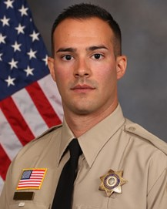
SESSION #2
A
Rich Randolph
Deputy Daniel Lopez

Slide 34
February 4 2022 CASCWA RE Supporting student behavior
corporal RICH RANDOLPH COLTON PD
San Bernardino/riverside school resource officers association president

Slide 35
ADMONISHMENT
- Todays Presentation is a compilation of suggestions and information from my experiences
Colton PD and the City of Colton have always valued its community policing and youth advocacy. (35% of the population is under the age of 18)
- School INTERNAL Collaborations are a team effort, administration, counselors, teachers, public safety, inter district (student services, transportation, human resources
- EXTERNAL Collaborations – Neighboring Districts, School Resource Officers neighboring agencies, courts and probation, district attorney and public defenders, City Resources (Public Works, Businesses
Admonishment, I do not consider myself an expert and programs/collaborations are working all over the country, all we can do is share and learn from each other!

Slide 36
What does a School Resource Officer do?

Slide 37
The role of a SRO, Years prior to Covid/Police Reform.
A SRO has a diverse role in the school and community and has many duties and responsibilities. These duties must extend into the community to protect our children and staff members.
We have defined a School Resource Officer as a sworn officer assigned to a school on a long-term basis trained to perform three major roles: law enforcement officer, law-related counselor, and law-related educator. In addition, the officer works in collaboration with the school and the community as a resource for safety and security issues.

Slide 38
The Role of the SRO has and needs to change
Online Enticement and Child Pornography rampant.
Law Enforcement alters its course to online crime monitoring/investigations
Attacks on law enforcement in schools.
Human Trafficking and Online Bullying is real, we must accept that and work together to protect our children.

Slide 39
The Role of the SRO After Covid.
- The SRO is the Ambassador of the law enforcement agency and the profession to our youths!
The inter connect between the district and the city/school district.
A resource for the school, teachers and staff away from school after hours. (Gaggle alerts or welfare checks)P
It is the SROs job to rebuild, reestablish and connect with the school community .
Mask Enforcement, social distancing is not a law enforcement role

Slide 40
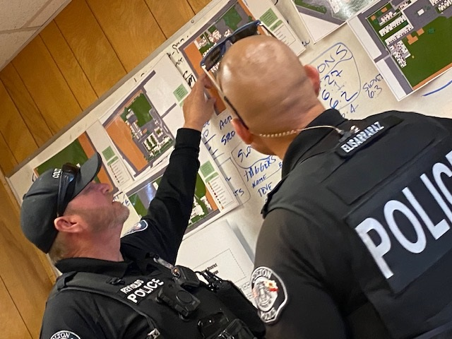
Collaborations on Campus

Slide 41
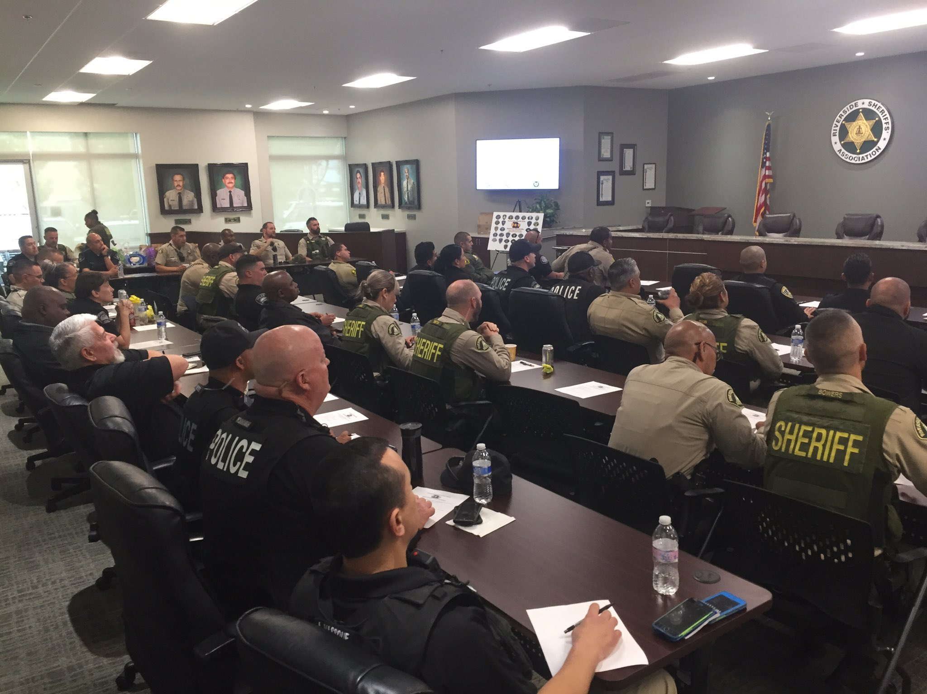
ESTABLISHED – 2017
Network of School Safety Officials Bringing both SB/Riverside County together.
SRO Alert – Group Text, Streamlining all information to the membership
Annual training each year, CPS, Social Media, latest trends on campus,

Slide 42
Inland Empire Law Enforcement Statistics (September to December)
Online Social Media Posts, threats regarding shooting schools, persons 370 REPORTS (Investigations, Arrests and or reports)
(This is not including San Bernardino, Riverside County Sheriff Departments (Stats still pending)
Online Social Media bullying/online posts towards faculty members
190 Reports
School Shootings 2021- 34
NCMEC (National Center for Missing and Exploited Children)
Reports (100 a month) Over 2,000 Reports since the start of school.
(Per US Title Code 18) Requires the reporting of anything that may be related to child porn, sexual enticement of a child, exploitation.

Slide 43
Thank you for your time/ Questions? Corporal Rich Randolph – Colton PD 909 370 5000 / rrandolph@coltonca.gov

Slide 44
https://www.youtube.com/watch?v=1QErOTmyFkc

Slide 45
SESSION # 3 - Expert Panel Moderator
Leslie hansen

Slide 46
Expert Panel Members
Dr. Katarina roy Schanz - RUSD

Slide 47
Expert Panel Members
Monique Yessian - TUSD
Yvette Magana - AESD

Slide 48
Creating a District-wide Employee Wellness Program
Dr. Katarina Roy Schanz and Diana Twiss, M.A.
Riverside Unified School District, Wellness and Engagement
February 4, 2022

Slide 49
History of Wellness and Engagement
Student Assistance Program
Counseling and related services with Licensed Therapists
Behavior with School Psychologists
School, Family, and Community Partnerships
Serving Families
Diana as Consultant
Transition to Full-Time Teacher on Special Assignment
Notes:
Katarina

Slide 50
Current Wellness and Engagement Program
Wellness Workshops
Burnout, Fostering Resilience, Be a Learner
Other Wellness Professionals (SAP, School Psychs)
Outside Businesses/Partnerships
Employee Community Circles
2x weekly
Special events/seasons
Notes:
Diana

Slide 51
Current Wellness and Engagement Program
cont...
Small Groups
Art Journal
Book Club
Mindfulness Self Compassion
Gallup Strengths Champions
Co-facilitate
Gallup Strengths Coaching, workshops, etc.
Notes:
Diana

Slide 52
Current Wellness and Engagement Program
cont...
1:1 Coaching
Employee Wellness Calendar
Weekly and Monthly
Annual Employee Wellness Fair
Notes:
Diana

Slide 53
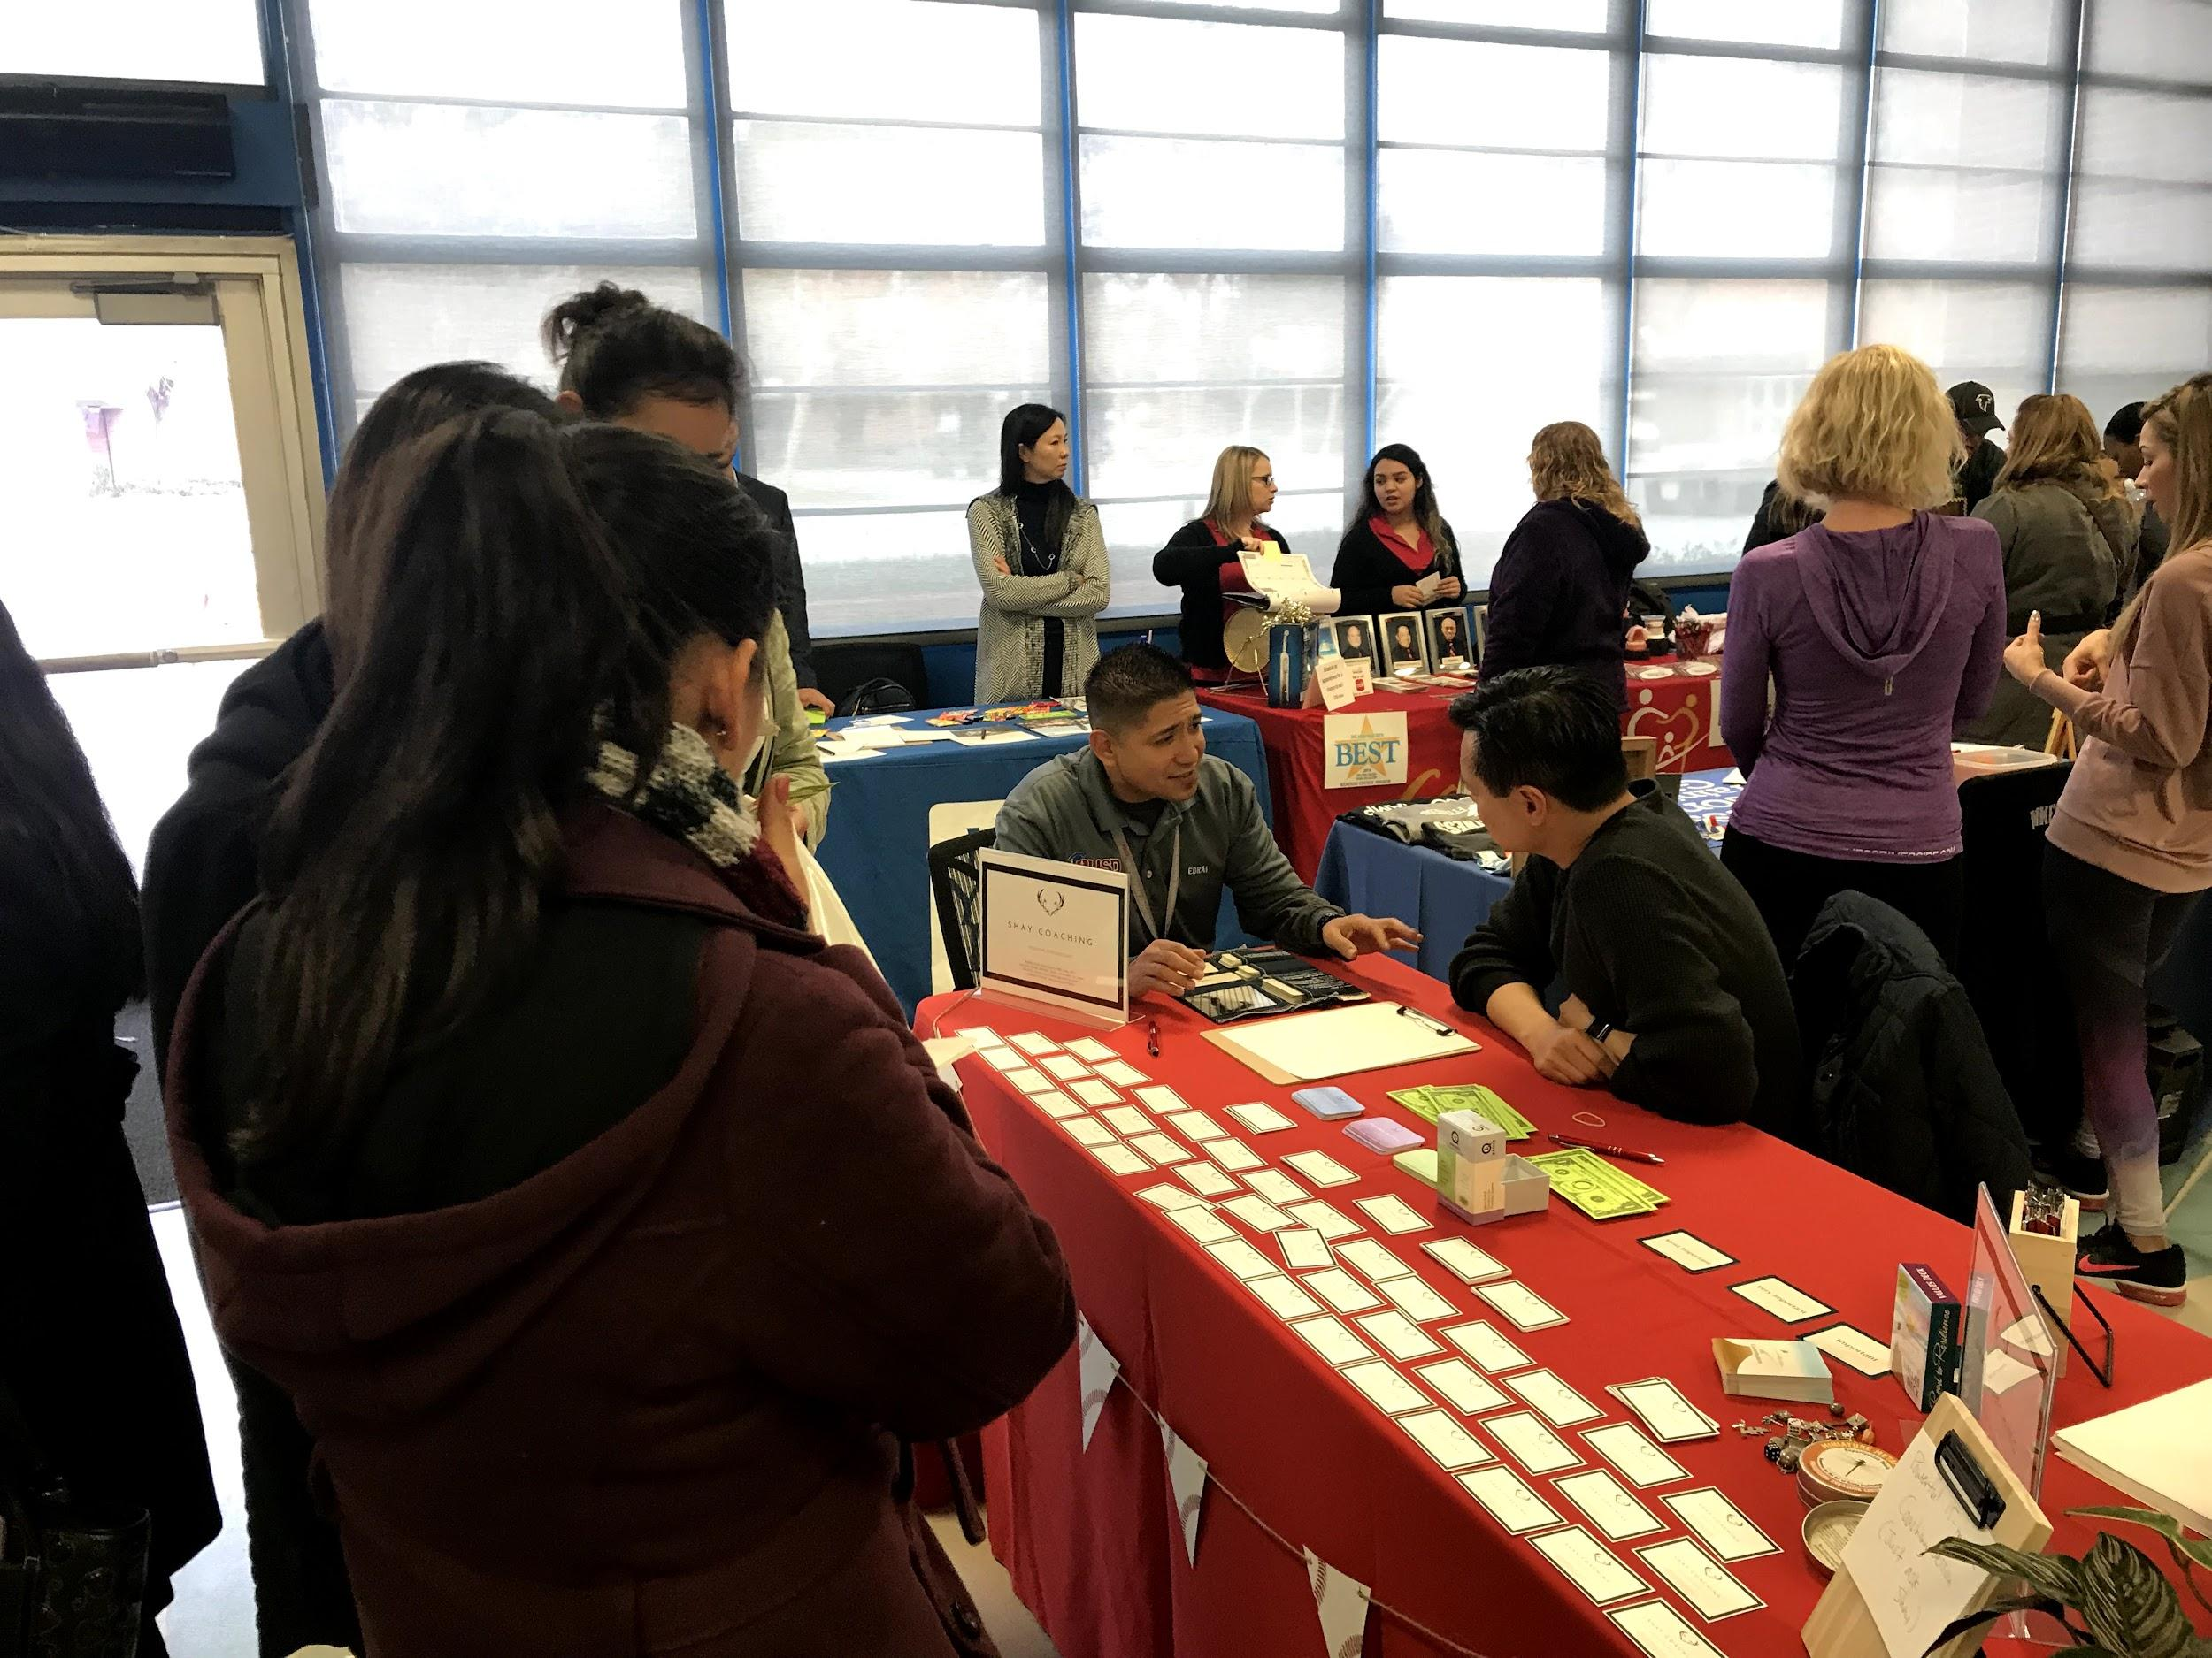
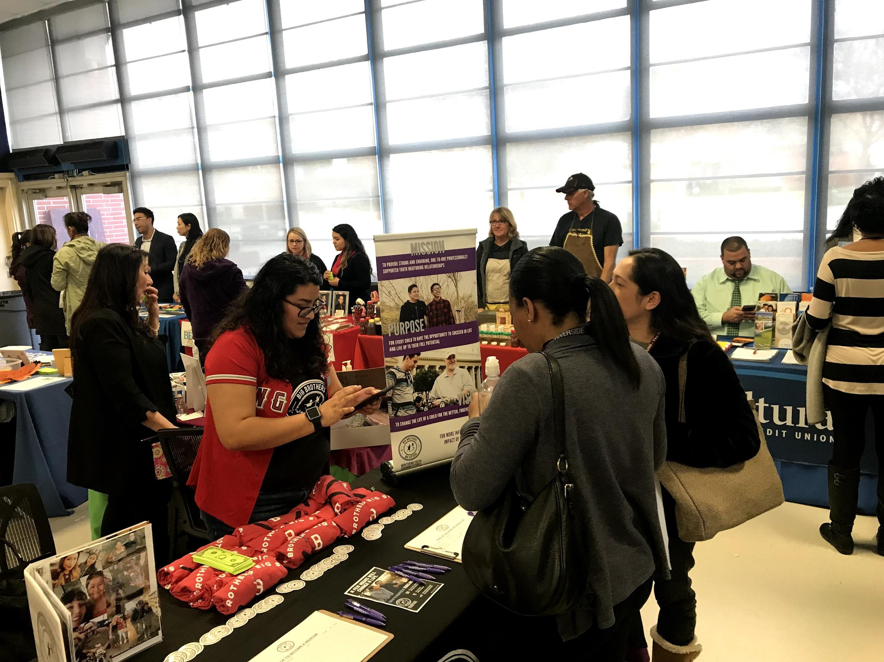
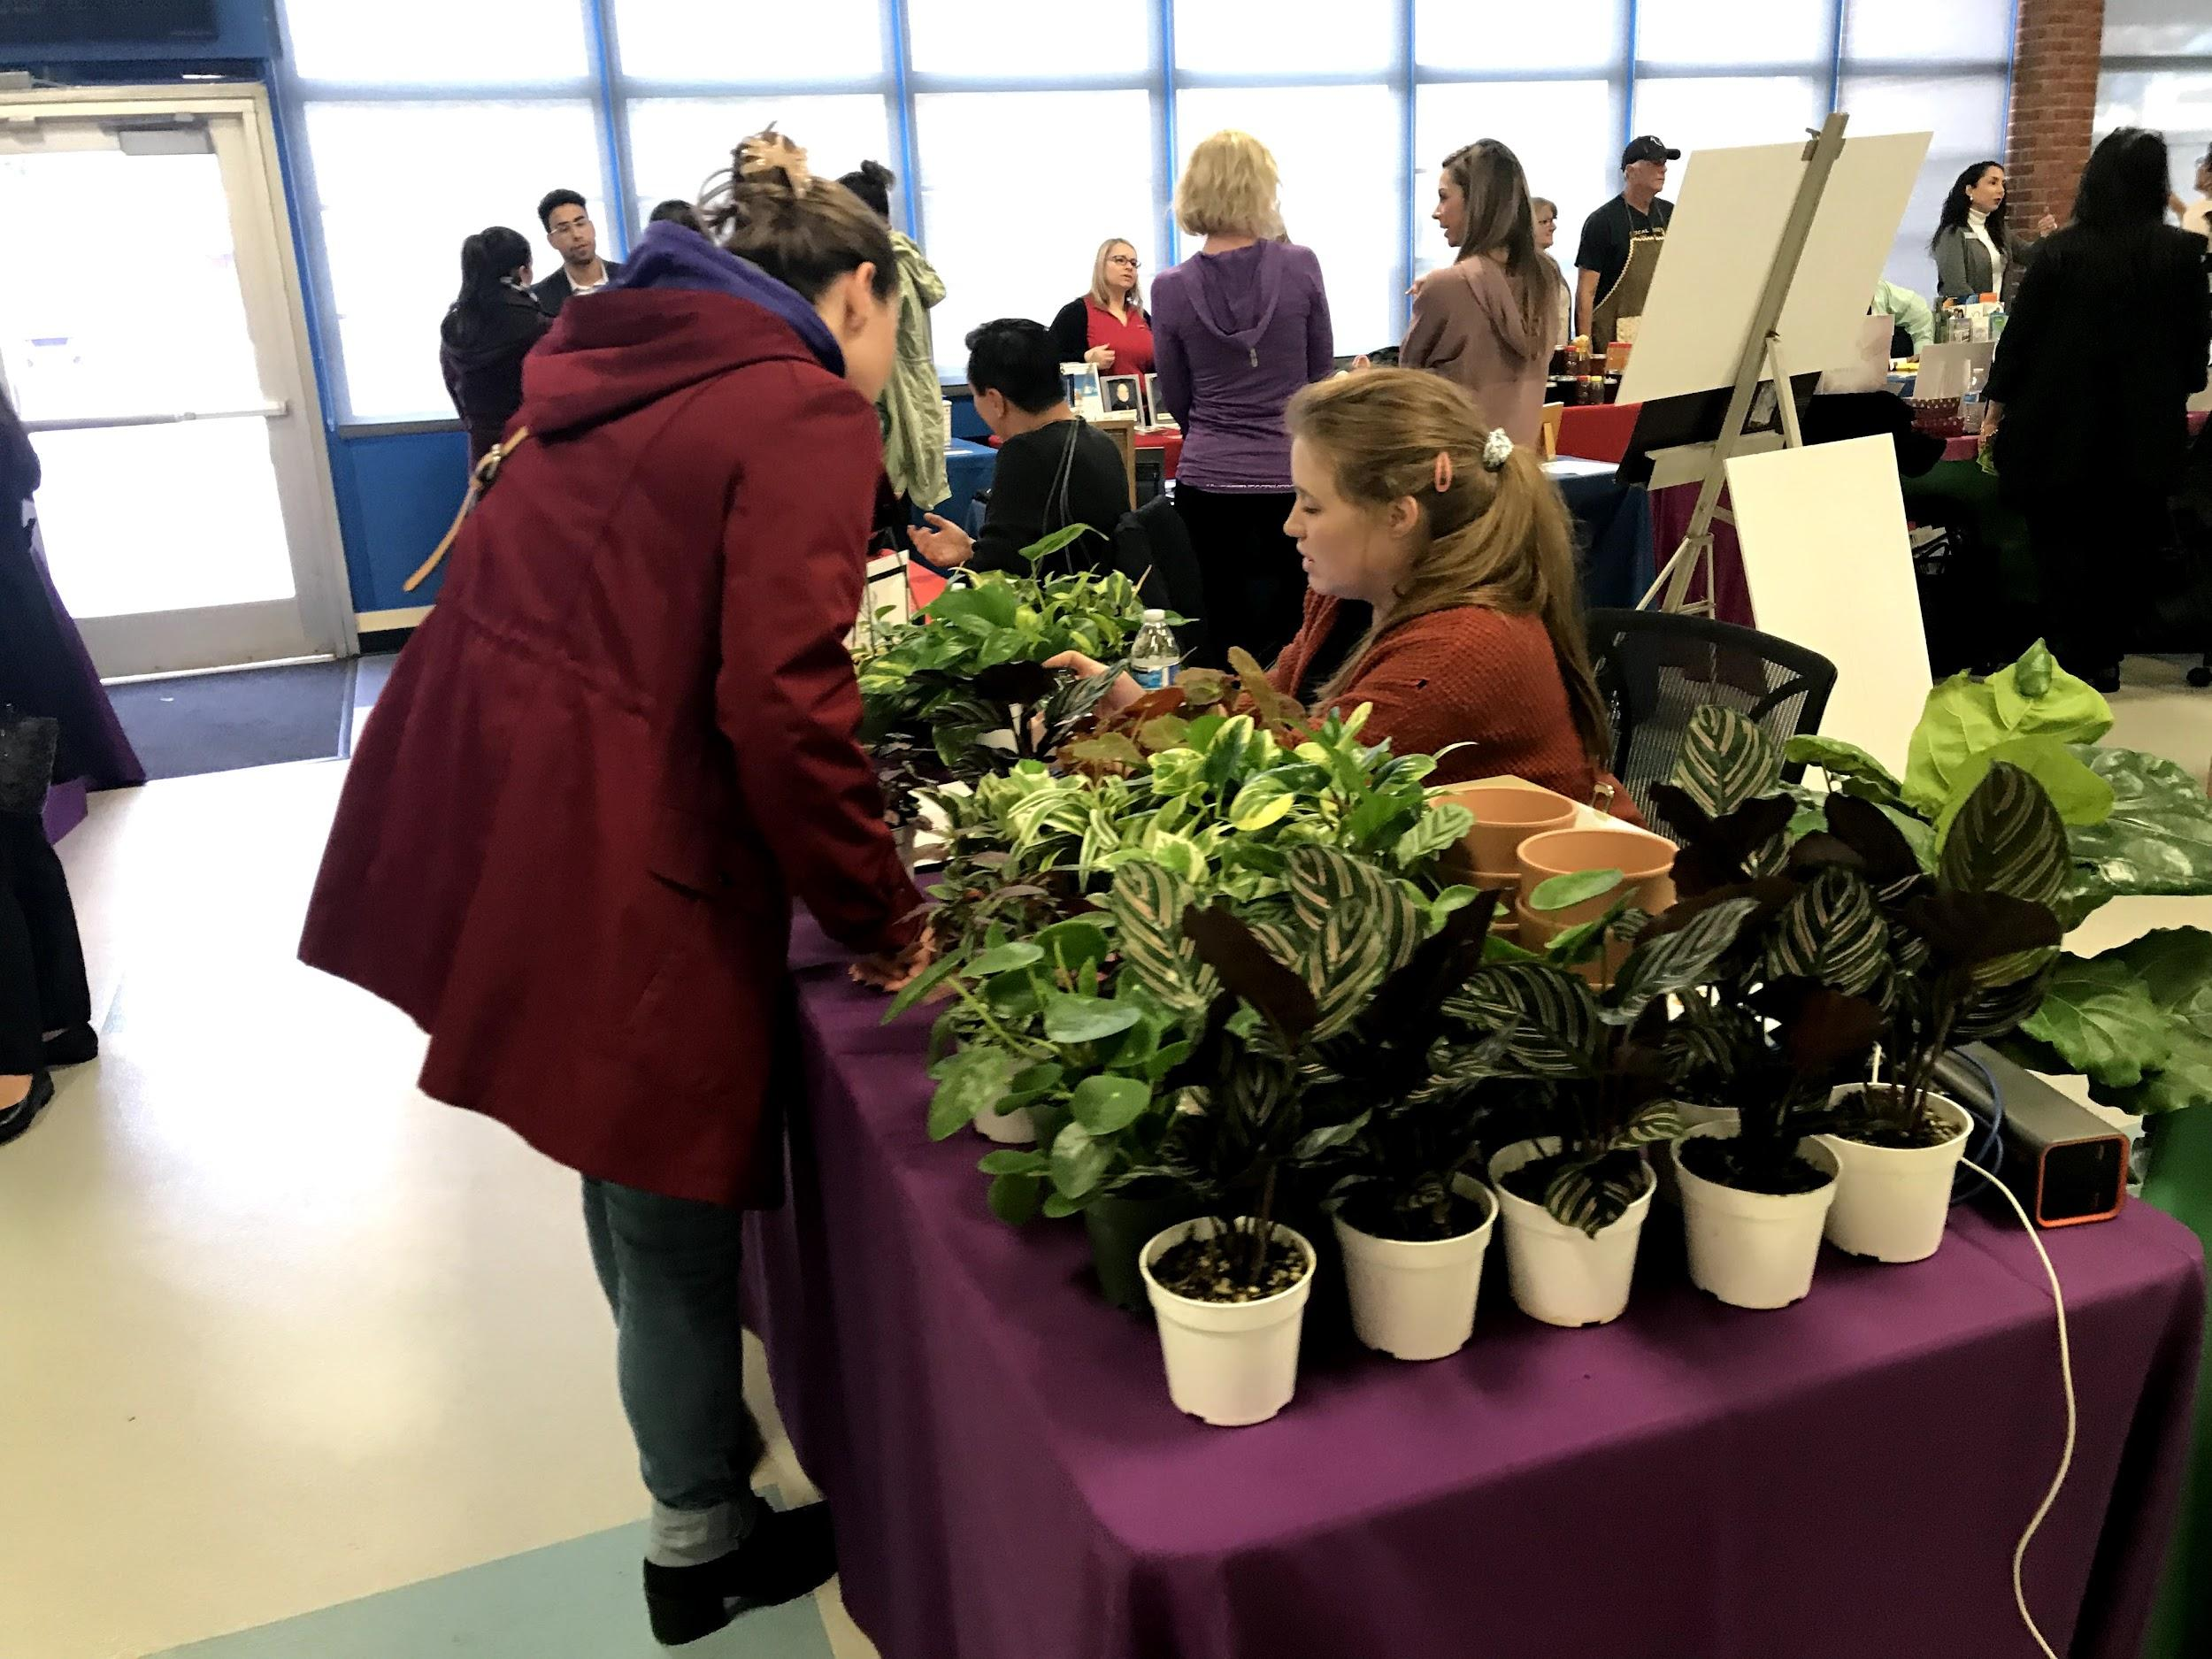
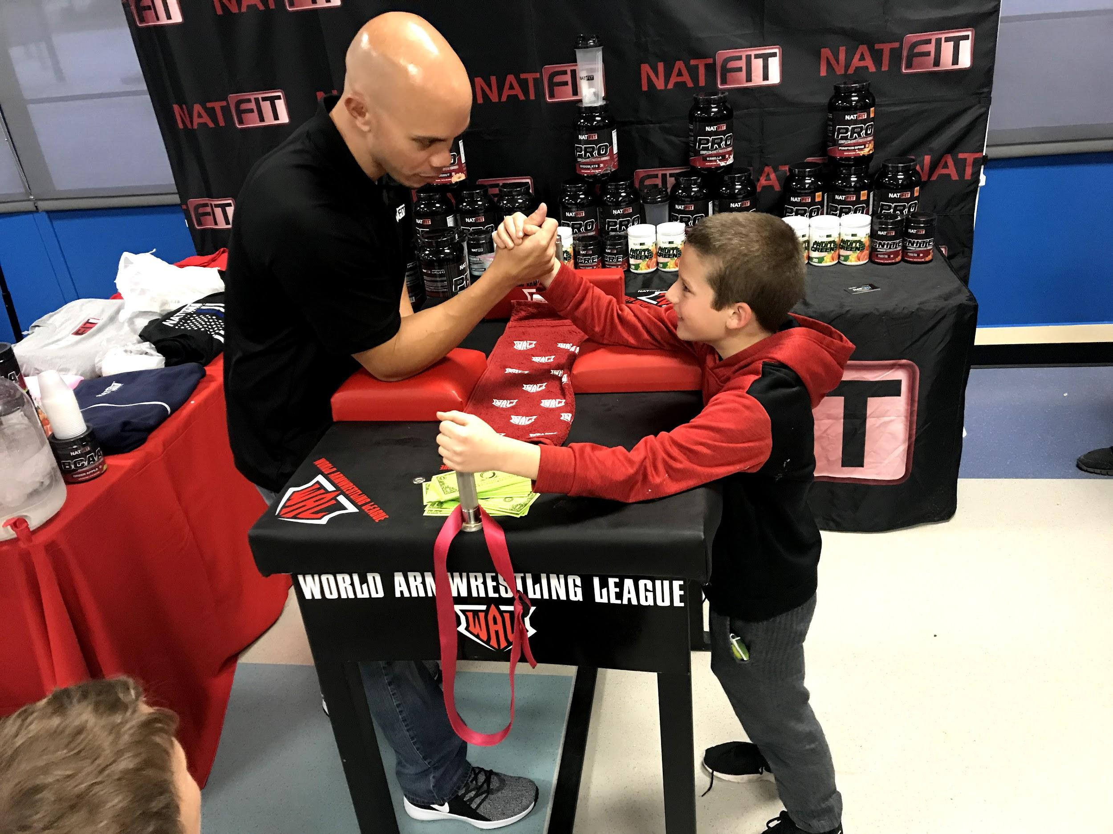
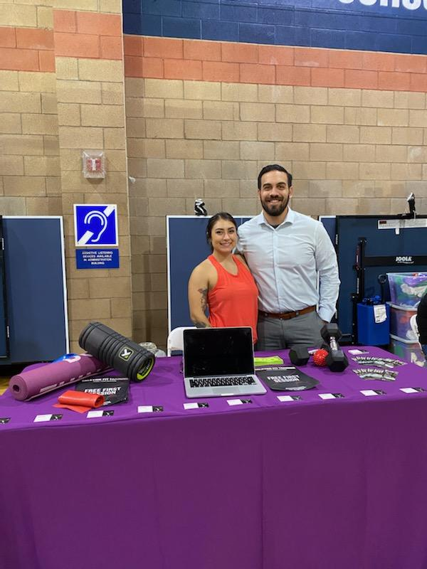

Slide 54
MENTAL HEALTH & WELLNESS: A COLLABORATIVE APPROACH
Tustin Unified School District
Monique Yessian
Director, Student Services

Slide 55
THE MENTAL HEALTH SERVICES TEAM
The Mental Health Services Team (MHS)
Licensed professionals, LMFT, LPCC, LCSW
Currently at 14 Mental Health Specialists supporting students in general education
Roles and Responsibilities
Mental Health Lead
Mental Health Specialist

Slide 56
SCHOOL STAFF PROFESSIONAL DEVELOPMENT AND SUPPORT
Topics Covered
Trauma Informed Care Workshop
Crisis Protocol
Suicide Awareness, Prevention & Intervention Training
Self Care and Mindfulness
Format Delivery
Coffee Talks/Personalized
Consultations
Lunch and Learns
Professional Learning Communities (PLC)

Slide 57
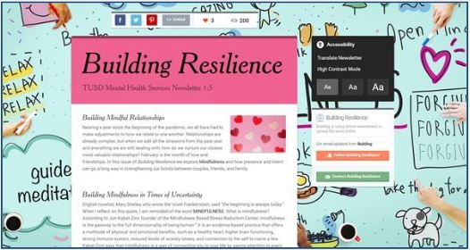
Parent & Family Events
PTO Education Nights
Coping through COVID
Managing Stress/Anxiety Mental Health 101
Social Media
Principals Coffee and Coffee with the Counselor
Suicide Prevention and Intervention
ELAC meetings
MH Newsletter: Building Resilience

Slide 58
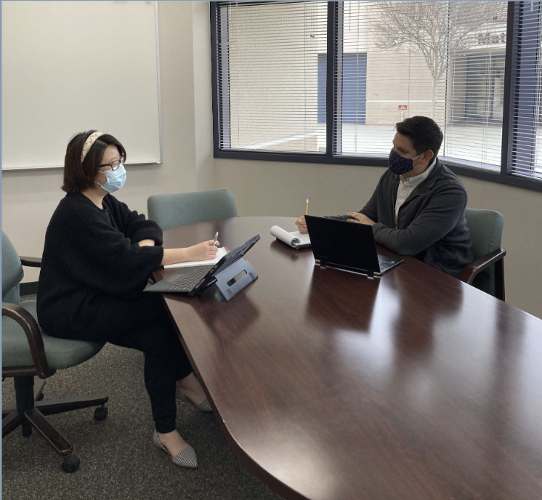
Mental Health Specialist &
School Counselor Collaboration
Continuum of Care
Roles and Responsibilities
Services, Support & Collaboration
Coordination of Care
Mental Health and SEL Lessons
Trauma Informed Workshops
Internship Program
Student Engagement and Linking

Slide 59
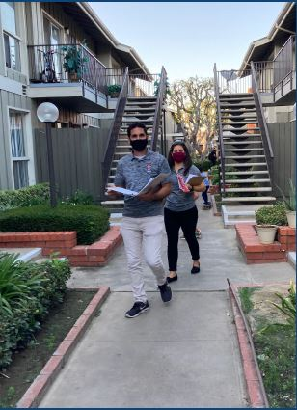
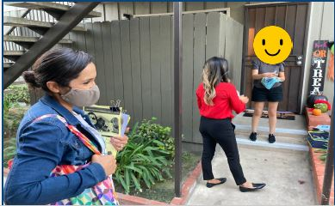
STUDENT ENGAGEMENT AND LINKING
Student Check Ins
Virtual counseling check-in form office hours
Bi-monthly check-ins with all foster youth (100+ students)
Tackling Engagement and Attendance
Conducted 107 home visits
Attendance: Conducted 29 SARB meetings in person
McKinney Vento: Ensured access to distance learning
Foster Youth- surrogate support to access Mental Health

Slide 60
Supporting Staff & Students Through a Trauma Informed Lens

Slide 61
Hello!
Yvette Magaña
CWA Coordinator
Anaheim Elementary School District
ymagana@aesd.org
714-517-7526

Slide 62
Vicarious Trauma

Slide 63
Research has shown that the nervous system of the helper can respond in ways that are similar to the direct trauma victim.
Rothschild, B. (2006)
Notes:
Feeling the same emotions as a trauma victim can lead to similar symptoms i.e. intrusive images, nightmares, insomnia, nervousness, jumpiness, difficulty concentrating or taking in information, emotional numbing, feelings of disconnect, changes in worldview, anger, hopeless, helplessness

Slide 64
Empathy vs. Compassion
Empathy- Feeling the Same Emotion
Often happens without conscious awareness
May be overwhelming and lead to feelings of distress
Can lead to withdraw from the person in need of help
Compassion - Feeling Care and Concern
Requires conscious awareness
Leads to positive emotions
Involves a focus on being helpful
Is more sustainable

Slide 65
Turning Empathy Into Compassion
Self-Monitor for signs of emotional overwhelm, what tends to overwhelm you?
Stay Calm - slow down, deepen your breath, say something reassuring, use imagery (mindfulness)
Be conscious of mirroring the emotions of others, use it to a positive advantage
Don’t forget to take care of your physical, emotional, spiritual and social needs on an ongoing basis
Notes:
Experiencing compassion is a less distressing emotion, helps us stay focused on what is helpful, we are calmer and less reactive, our nervous system stays in a healthy state, we are more likely to be successful at being helpful.

Slide 66
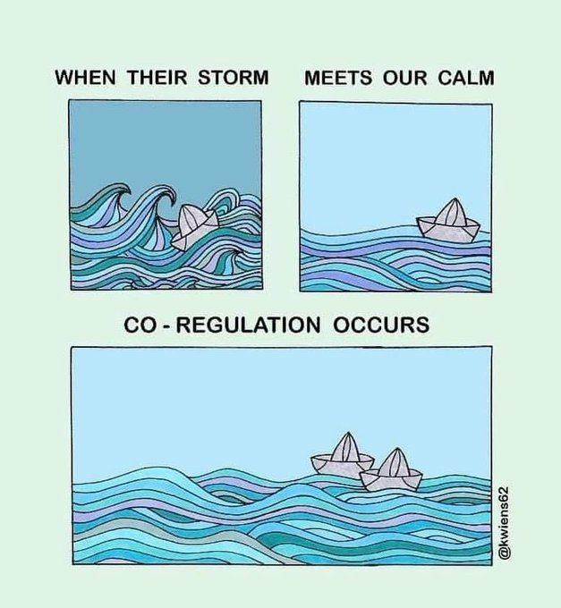
Why is Self Care so Important

Slide 67
Co-Regulation 101
Notes:
From Parenting Works

Slide 68
Trauma Informed Practices for Supporting Students
Soothing the Survival Brain
Music, dance, drumming, rhythm
Movement
Sensory experiences/opportunities
Breathing, mindfulness, relaxation strategies
Soothing the Emotional Brain
Focus on safety
Predictability, routines and expectations
Increase opportunities for special relationship building with caring adults (not tied to academics)
Primarily positive reinforcement; minimize punitive interventions
Ample opportunities for creative self expression
Have Fun!

Slide 69
Strengthening the Thinking Brain
Help children form positive ideas about themselves, others, and the world
Positive feedback & opportunities for self-exploration
Develop & teach appreciation for positive relationships
Increase exposure to interesting experiences, individual interests & extracurricular activities
Explicitly teach how to manage learning
Break down assignments
Use planners and teach organizational skills
Formulate goals and break them down into successive steps
Notes:
Because students who have suffered repeated exposures to trauma often have over developed survival and emotional brains, they often have underdeveloped cerebral cortexes. This is why we need to explicitly strengthen and develop this part of the brain to support learning.
Students w complex trauma histories are focused on the here and now and often have a sense of a foreshortened future. They can’t think far in to the future, this greatly impacts the motivation to learn and the ability for self-exploration.

Slide 70
Strengthening the Thinking Brain
Teach an awareness of the nervous system and the basics of brain development
How soothing the survival brain helps us access our thinking brain
Teach symptoms of trauma exposure to normalize experiences
Discipline
Consider if the discipline employed builds the child’s ability to exercise self-control in the future
Collaborative Problem Solving
Restorative Practices
Notes:
Because students who have suffered repeated exposures to trauma often have an over-developed survival and emotional brains, they often have underdeveloped cerebral cortexes. This is why we need to explicitly strengthen and develop this part of the brain to support learning.

Slide 71
Thanks!
Any questions? You can find me at:
ymagana@aesd.org
714-517-7526

Slide 72
Future EVENTS
Scholarship Program
Do you have a student who has overcome trauma or adverse experiences? Consider having your student apply for the Lillie Wilson Scholarship in April of 2022. For more information on Southern Section Scholarship, check out: https://cascwa.wildapricot.org/Scholarships
CASCWA State Conference
May 11-13, 2022 IN-PERSON, May 12 VIRTUAL
Sponsored by Delta-Sierra Section and being held in Lake Tahoe
Information & Registration: https://cascwa.wildapricot.org/Conference
Membership Reminder http://cascwa.wildapricot.org/To-Join

Slide 73
CASCWA WEBSITE
Check-out the CASCWA Website at
http://cascwa.wildapricot.org/

Slide 74
Educator’s Guide to Comprehensive School Safety Plans (2021 Edition)
Formerly known as, “Safe Schools: A Planning Guide to Action” [EC 32282(b)]
Last update was in 2002
Prepared by Campus Safety Group experts, as part of the strategic partnership between LACOE, CDE, DOJ, OES, and other stakeholders
Ordering information:
Email - Elizabeth Iniquez at Iniguez_elizabeth@lacoe.edu
Notes:
DOJ = California Department of Justice
OES = California Governor’s Office of Emergency Services
The updated edition addresses pandemic response, tactical response, mental health intervention, and methods to improve school climate and physical safety
The guide explains how to ensure compliance with CSSP regulations, and provides templates and resources.

Slide 75
Campus Safety Group A non-profit corporation https://campussafetygroup.org/
Upcoming Webinars
Compliance Project
Assist the school/school district establish a sustainable compliance process
Membership
Member schools/school districts have unlimited access to CSG training, resources, and support
February 8, 2022
March 8, 2022
April 27, 2022
May 18, 2022

Slide 76
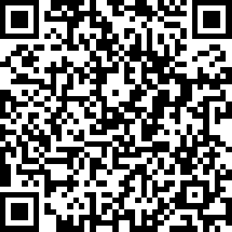
Evaluation
All of the participants who complete the evaluation by Monday 12pm will be entered into a raffle for a $100 Amazon e-gift card. Winner to be announced Monday afternoon via email.
https://www.surveymonkey.com/r/Y8656R2
Google Folder: https://drive.google.com/file/d/1ZO2JxgOK12uyJfu_Qq1k2KA5b30mB6UX/view?usp=sharing

Slide 77
Thank you for joining us today!
Southern Section

