Slide 1
Fall Workshop Follow up
Southern Section
Maximizing Learning Opportunities Through a Focus on Social Emotional Learning (SEL)
November 5, 2021

Slide 2
WORKSHOP’S OBJECTIVE
Maximizing learning opportunities through a focus on Social Emotional Learning (SEL)

Slide 3
WORKSHOP’S FOLLOW-UP
A special thank you to Vicente Bravo and the entire Southern Section team for this important workshop. There were three parts to the workshop filled with many thoughts and personal messages. The sessions moved quickly and it was difficult to take notes. The following slides will include the personal comments recorded by this editor. They may appear as single words or phrases, but when looked at from a distance they reflect the messages delivered in this brief time period!

Slide 4
THE WORKSHOP’S Agenda
Student Panel
Moderator: Kevon Lee – Youth Speaker & Author
Expert Panel Members
Moderator: Don English – Director, San Bernadino County Superintendent of Schools
Sunny Shen – Director of Prevention & Intervention, Irvine Unified School District
Roy Juarez Jr. – COE & Founder IMPACTtruth
Amanda Deniston – Coordinator of CWA for Moreno Valley Unified School District
Dr. Helen E. Morgan – Superintendent of Hawthorne School District
Dr. Emily Green – Da Vinci Schools Lead Nurse
Featured Speaker
~Ray Culberson~
CBO Entrepreneur High School

Slide 5
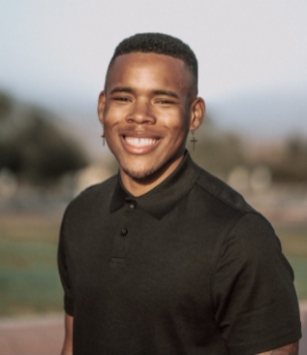
Student Panel
Moderator: Kevon Lee – Youth Speaker & Author
Kevon Lee

Slide 6
Student Panel - Comments
Kevin and 8th 11th 12th Graders… Covid… On-line… Mentor… Personal… Believe in yourself… Not care what others think… Self Actualization… Barrier ourselves… Accommodations… Youth violence is very important… Over thinking… Once we connect with ourself… Grades GPA… Right job… Right college… Focus… Student Happenings… Not focused… Good qualities… Who people are… Figure out… Enjoy through learning… Got to know students on a deeper level… Little things… Student need to share a little bit about their self… Can change someone… Invest in students… School more than just a job… Students go to school to do their best… Be disciplined… Invest in yourself…

Slide 7
Student Panel Comments - Continued
Math life culture in general… Don’t let others upset how you feel… Only if you let them… Emotions… Stay calm… Those that anger you can control you… You control… Respect… How you come off as a person tells a lot about you… It is not who you know… It is a lot about who likes you… Learning never stops… Be happy make others happy!

Slide 8
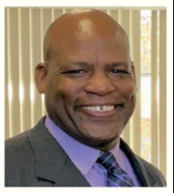
Expert Panel Moderator
Don English

Slide 9
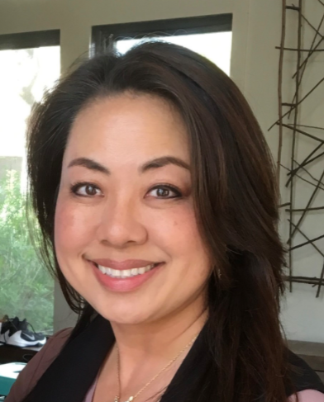
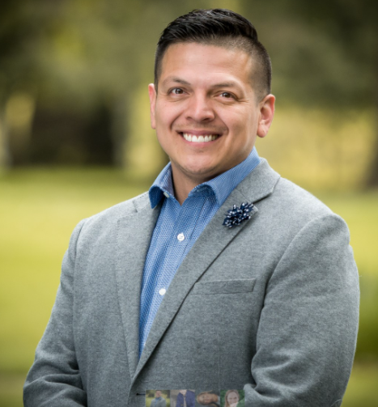
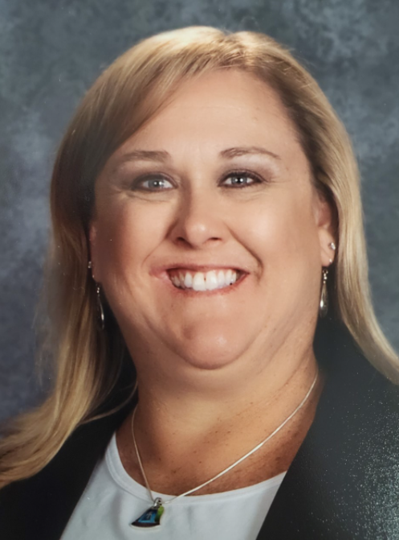
Expert Panel Members
Sunny Shen
Roy Juarez Jr.
Amanda Deniston

Slide 10
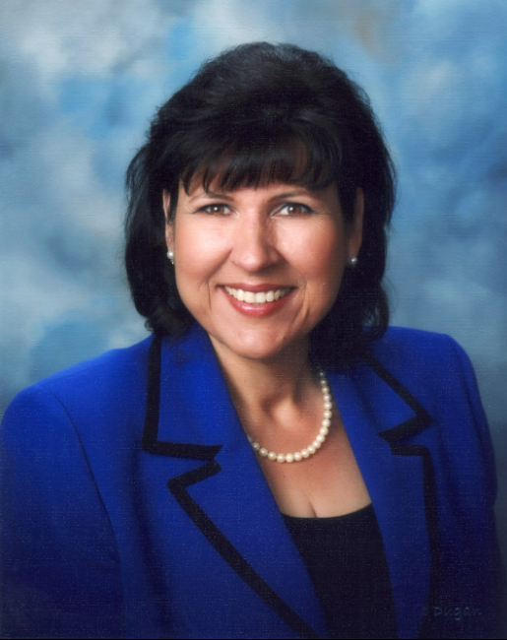
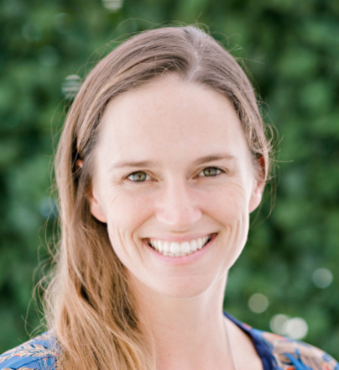
Expert Panel Members
Dr. Helen E. Morgan
Dr. Emily Green

Slide 11
Expert Panel Comments
Nurse… Connect students… Diversity… Want to be supportive… Socio economic level… Quality of teachers of student incredible impact…Tools in the toolbox… Discuss habits before control… All about relationships… Prevention intervention…Depression suicide prevention… Not reactive… proactive… Interactive restorative practices… Evidence based curriculum… Diagnostic… Tier one level… Student services partnering… Behavior rehabilitation… Grappling with issues… Engagement… Make kids want to be in school… Behaviors… Attendance indicators… How does it all come together… Data PBIS…

Slide 12
Expert Panel Comments - Continued
What are the root causes of issues… Why is attendance on the back burner??? Partnership with mental health… Collaboration for collective impact… Have not seen doctor… Anxiety… Half of kids unmotivated… Great number of students lost someone to covid… Support… Triage… Exposure still comes… Kids showing up sick… Teachers have so much on their plates… Support to staff and community… Kids in chaos… Planning time… Independent Study… Huge Investment Technology Professional development supplies materials… Unusual times unusual measures… Won’t go on forever… Trauma…

Slide 13
Expert Panel Comments - Continued
Bigger impact bigger picture… Validate students who they are… We are here for the kids… Kids in chaos… Career… Underdogs… Keeping kids out of the system…

Slide 14
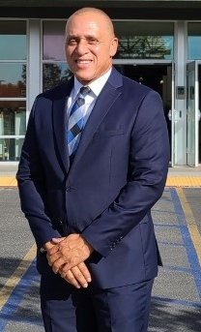
Feature Speaker
~Ray Culberson~
CBO Entrepreneur High School
A
RAY CULBERSON

Slide 15
Feature Speaker Comments
~Ray Culberson~
CBO Entrepreneur High School
Ray Culberson speaks from his heart and from his life! He is an accomplished educator and continues to fight for those good decisions all educators can make to motivate, encourage and point students into making decisions for the betterment of their lives. In his lifetime, Ray has overcome adversity and unique challenges. He has a great message for all students and is a motivational speaker extraordinaire. He delivered a thought provoking presentation for all to hear. We encourage all of you to hear Ray in person in the future. Thank you Ray for all you do for the children in California!
A

Slide 16
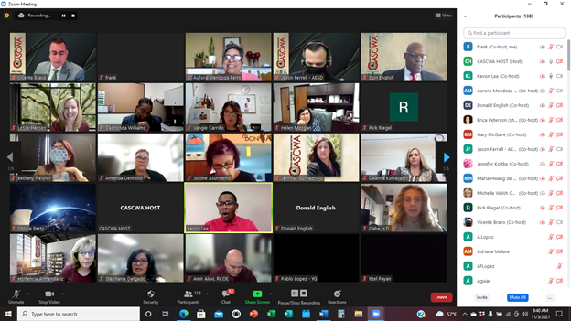
Workshop Zoom Pictures! Enjoy!
A

Slide 17
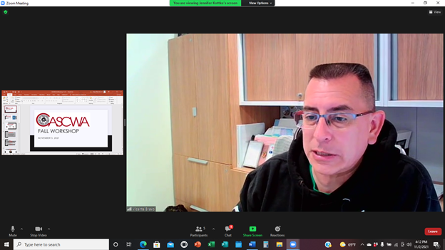
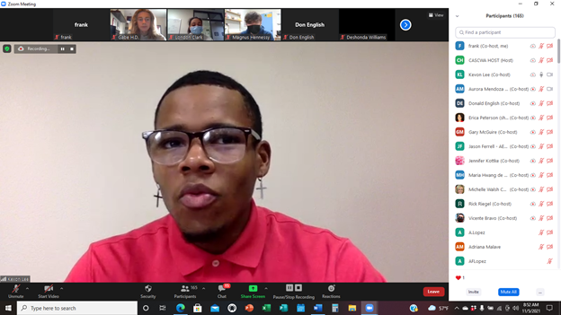
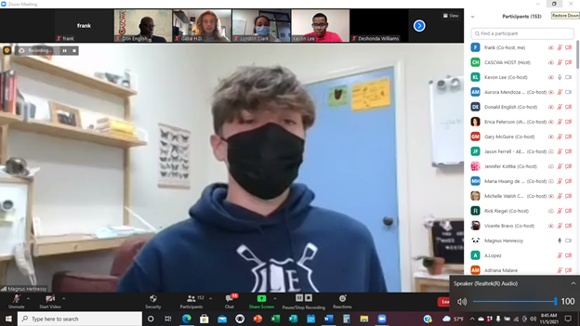
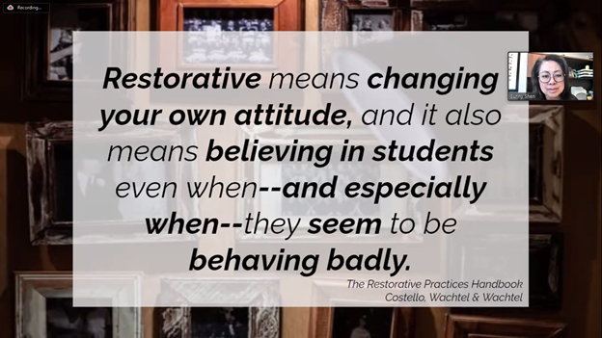
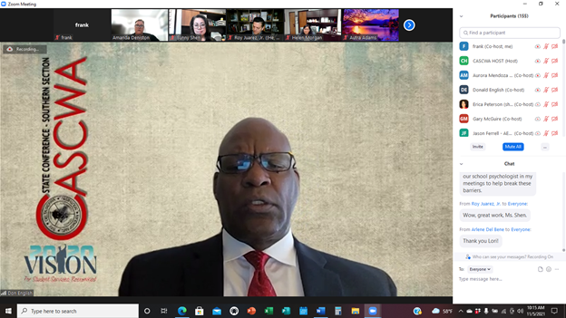
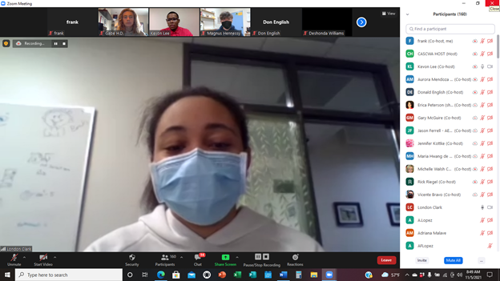

Slide 18
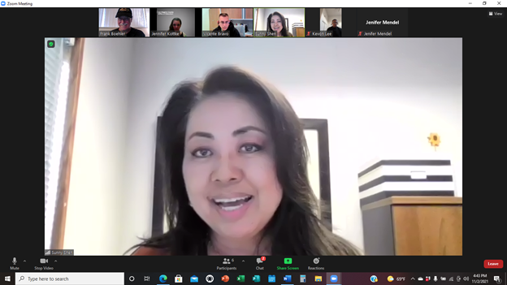
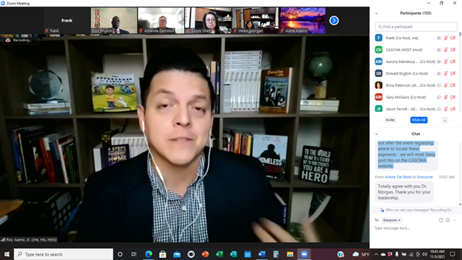
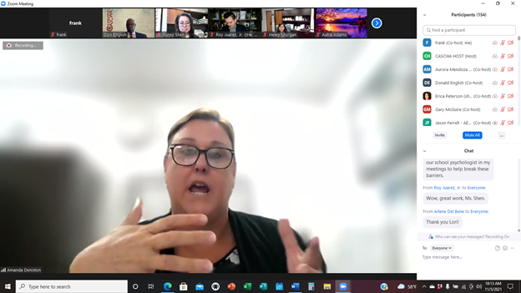
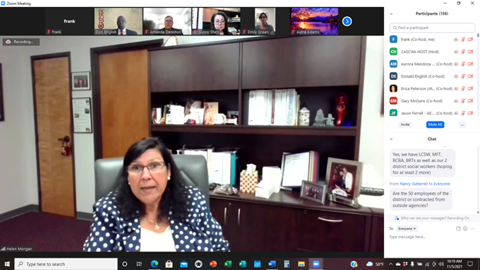
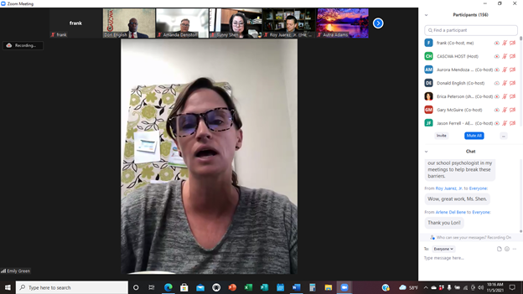
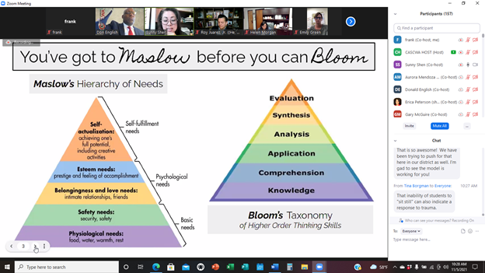

Slide 19
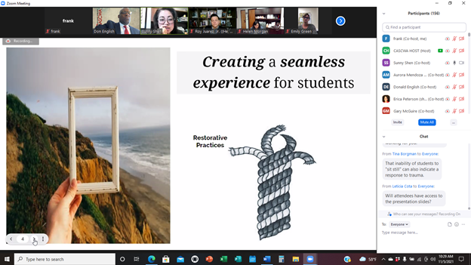
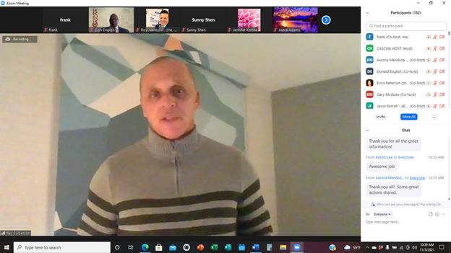
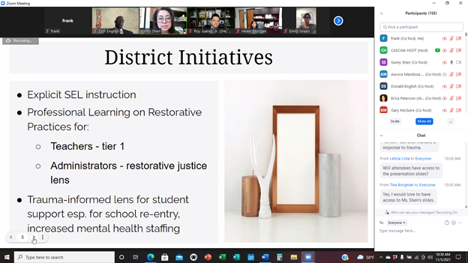
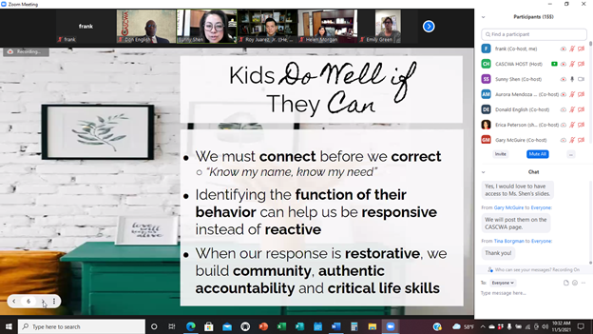
Workshops are only successful when the attendees return to their districts and agencies with motivation, more tools in their tool box and a vision for positively impacting their students. We hope all attendees found this workshop to be meaningful!

Slide 20
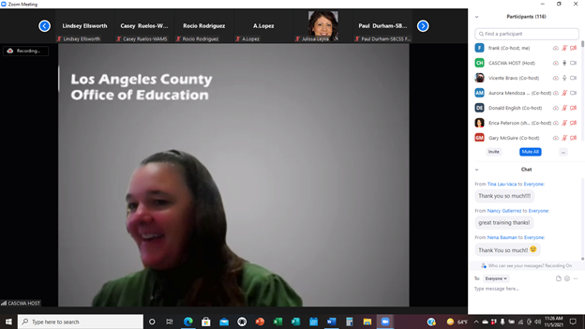
Special Thank You – Long Overdue
LACOE’s Jennifer Kottkee
The Los Angeles County Office of Education has incredible history with CASCWA, like no other organization. CASCWA is grateful to Jennifer Kottke. She has been instrumental in making several of our Zoom events a reality. Thank you Jennifer!

Slide 21
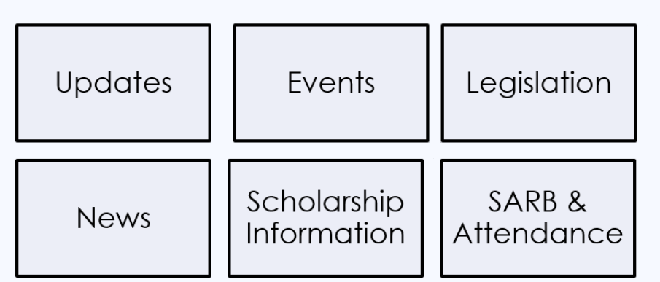
CASCWA WEBSITE
Check-out the CASCWA Website at
http://cascwa.wildapricot.org/

Slide 22
Future EVENTS
Legislative Update
December 3, 2021
Hosted by LACOE and sponsored by CASCWA
REGISTRATION:
http://lacoe.k12oms.org/2141-201919
Scholarship Program
Do you have a student who has overcome trauma or adverse experiences? Consider having your student apply for the Lillie Wilson Scholarship in April of 2022. For more information on Southern Section Scholarship, check out: https://cascwa.wildapricot.org/Scholarships
Phil Kauble Topical Forum
Feb. 4, 2022
More information to come
Mark your calendar now!
CASCWA State Conference
May 11-13, 2022 IN-PERSON, May 12 VIRTUAL
Sponsored by Delta-Sierra Section and being held in Lake Tahoe
Information & Registration: https://cascwa.wildapricot.org/Conference
Membership Reminder http://cascwa.wildapricot.org/To-Join

Slide 23
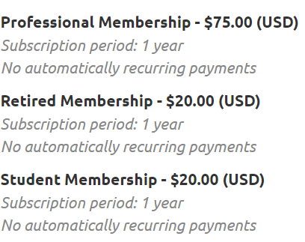
Membership
MEMBERSHIP LINK
http://cascwa.wildapricot.org/To-Join

Slide 24
Thanks to All of you who attended our workshop and to those of you who enjoyed this power point follow-up!
Southern Section

