Slide 1
Andrea Valtierra-Gongora District Attorney Investigator Motivation to Study https://www.bing.com/videos/search?q=the+importance+of+school+attendance+video&&view=detail&mid=E116354037F4C29E411EE116354037F4C29E411E&&FORM=VDRVRV Dream Motivation - Spanish Subtitles
Here to Learn Program

Slide 2
Here to Learn Program
Implemented in 2017
Joint effort by the Merced County Office of Education, the District Attorney’s Office, and 20 school districts in Merced County.
Goal is to improve student attendance

Slide 3
Role of DA Investigator
Conduct home visits
Review Aries attendance history; CalPads history
Assist with enrollment
across multiple districts/counties
Refer families to resources as needed
Behavioral Health, CPS, MCOE – SOS, Comeback Charter School
Attend SARB Hearings
Review sibling attendance history across multiple districts
Community outreach (presentations/meetings)
Provide updated attendance information to prosecutors
Provide SARB related court dispositions to districts
Coordinate enforcement activities related to SARB related criminal violations.
Notes:
18 y.o. drop out – Comeback Charter; two younger siblings 3rd & 5th Grade (170 absences – Referred to SARB).
The 272PC case handled now may prevent a 187PC case later.
Birth Certificates
Shots – Medical Appointments

Slide 4
District Attorney Referrals Improved Attendance
 | 2013-2014 | 2014-2015 | 2015-2016 | 2016-2017 | 2017-2018 | 2018-2019 | Total Absences Per Student
Student 1 - Absences |  | 48 | 67 | 81 | 17 | 3 | 216
Student 2 - Absences | 31 | 18 | 40 | 44 | 12 | 3 | 148
Student 3 - Absences | 54 | 37 | 45 | 55 | 29 | 9 | 229
Student 4 - Absences |  |  |  |  | 27 | 11 | 38
Student 5 - Absences |  |  |  |  | 25 | 11 | 36
Student 6 - Absences |  |  |  | 76 | 52 | 11 | 139
Student 7 - Absences | 27 | 77 | 63 | 111 | 78 | 12 | 368
Student 8 - Absences |  |  |  | 29 | 31 | 13 | 73
Student 9 - Absences | 38 | 6 | 40 | 52 | 7 | 15 | 158
Student 10 - Absences | 15 | 29 | 46 | 58 | 105 | 15 | 268
Student 11 - Absences | 9 | 40 | 18 | 52 | 43 | 16 | 178
Student 12 - Absences |  |  |  | 35 | 48 | 21 | 104
Student 13 - Absences |  |  |  | 75 | 34 | 21 | 130
Student 14 - Absences | 43 | 52 | 49 | 46 | 36 | 24 | 250
Student 15 - Absences | 24 | 27 | 35 | 97 | 150 | 25 | 358
Student 16 - Absences | 11 | 14 | 30 | 71 | 35 | 29 | 190
Student 17 - Absences |  | 28 | 41 | 44 | 22 | 30 | 165
Student 18 - Absences |  |  | 64 | 49 | 61 | 31 | 205
Student 19 - Absences | 44 | 53 | 67 | 88 | 24 | 32 | 308
Total Absences | 296 | 429 | 605 | 1063 | 836 | 332

Slide 5
Misdemeanor Penal Codes
PC270.1: APPLIES TO MINORS GRADE 1 – 8. Parent/guardian of pupil 6 years of age or more . . . Who is chronic truant as defined in EC48263.6, who has failed to reasonably supervise and encourage pupil’s school attendance
EC48263.6: chronic truant is a pupil subject to compulsory education who is absent from school without valid excuse for 10 percent or more of the school days in one school year
PC272: APPLIES TO MINORS AGE 12 – 17. Every person who commits any act/omits performance of any duty, which causes/tends to cause/encourages any person under age of 18 to come within provisions … W&I601…
WI601: minor (age 12 – 17) has four or more truancies within one school year as defined in EC48260 OR minor fails to respond to directives of SARB

Slide 6
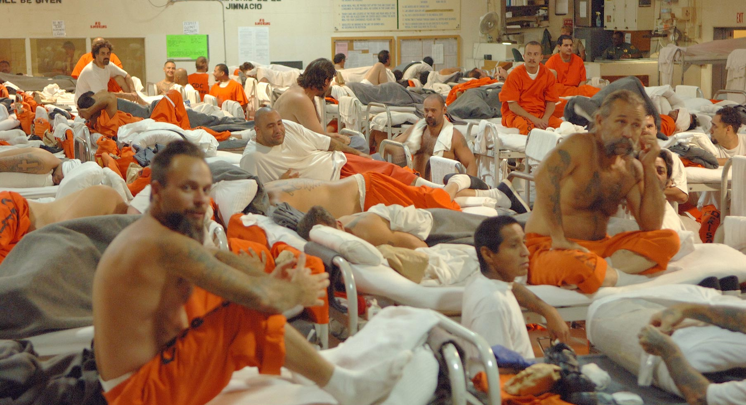
Facts
More than half of incarcerated youth have reading and math skills significantly below their grade level…
…and many had dropped out of school all together before being incarcerated.
LOCKED OUT: Improving Educational and Vocational Outcomes for Incarcerated Youth 2015
School dropouts are 3.5 times more likely to be arrested than high school graduates.
Schools v. prisons: Education's the way to cut prison population (op-ed by Deborah Stipek) 2014
Notes:
Nationally, 68 percent of all males in prison do not have a high school diploma. Only 20 percent of California inmates demonstrate a basic level of literacy, and the average offender reads at an eighth grade level.

Slide 7
Thank You!
Andrea Valtierra-Gongora
District Attorney Investigator
Merced County District Attorney’s Office
Office: (209) 385-7383, ext. 4233
Cell: (209) 564-2459

