Slide 1
PHIL KAUBLE TOPICAL FORM
https://www.youtube.com/watch?v=xuMJnE7TUGQ
Southern Section
Preparing For & Working Through Incident Response
FEBRUARY 9, 2024

Slide 2
WELCOME!
On-Line Meeting Norms
Click on links in the Chat Box to access materials
Google Folder: https://drive.google.com/drive/folders/1CTLqGx__i5Z7s9wsYlNFoW8JTmJY-Imi?usp=sharing

Slide 3
WELCOME!
In- Person Housekeeping
Evaluation
Agenda
FOLDER
Google Folder: https://drive.google.com/drive/folders/1CTLqGx__i5Z7s9wsYlNFoW8JTmJY-Imi?usp=sharing

Slide 4
TODAY’S AGENDA
Safe School Plans
~Tom Steele~
Director of School Safety Planning, Campus Safety Group
BREAK
Real Life School Safety Incident Response
Panel & Presentation
~Andrew Flores~
Director, Office of Emergency Management, University of California, Riverside
~Tim Walker~
Deputy Superintendent of Riverside Unified School District
~Dr. Gary McGuire~
Retired Director of Pupil Services, Riverside Unified School District
FINAL COMMENTS

Slide 5
Educator’s Guide to Comprehensive School Safety Plans (2023-24 Edition)
Campus Safety Group is incredibly proud to have been exclusively selected to write the “Educator’s Guide to Comprehensive School Safety Plans, 2023-2024 Edition”. This was a joint project between The Department of Education, the Department of Justice, the Los Angeles County Office of Education, as well as several other stakeholder agencies.
The 2023-2024 Guide to School Safety Plans is an essential first step towards compliance, however, LEA’s will still need training and support to assure they establish and maintain a “culture of compliance” with all safety mandates.
Ordering information:
Email - Elizabeth Iniguez at Iniguez_Elizabeth@lacoe.edu
Notes:
DOJ = California Department of Justice
OES = California Governor’s Office of Emergency Services
The updated edition addresses pandemic response, tactical response, mental health intervention, and methods to improve school climate and physical safety
The guide explains how to ensure compliance with CSSP regulations, and provides templates and resources.

Slide 6
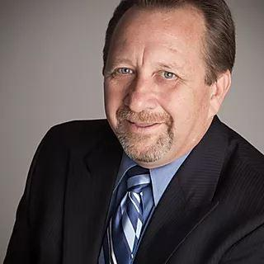
Safe School Plans
~Tom Steele~
Director of School Safety Planning, Campus Safety Group

Slide 7
Preparing For and Working Through Incident Response
“Schools are among the safest institutions for children”
Arne Duncan, U.S. Secretary of Education, Rethinking School Discipline, January 8, 2014 https://www.ed.gov/news/speeches/rethinking-school-discipline

Slide 8
Tom Steele
Retired Sergeant
Narcotics Detective, SWAT team
20 years TK-12 Education
High school teacher and administrator
District Director of Student Services
County Office of Education administrator
Community Health and Safe Schools
Positive Behavior and Interventions Supports (PBIS)
Campus Safety Group
Alumni 1st ACSA Pupil Services Academy!
Wrote the Educator’s Guide to Comprehensive School Safety Planning, 2022 Edition

Slide 9
Training Agenda
There is no “one size fits all” safety plan
Handouts
Comprehensive Safe School Planning History
Why do we need/Purpose
Responsibilities
Planning Process
Review policies / procedures
School Crime / safety data
Disaster preparedness
Behavior issues / harassment
Tactical response
Safe and Orderly Environment-Social Climate / Physical Environment
Compliance

Slide 10
What is a CSSP
(EC 32280-32288, 1997) Annual systematic planning process (Gap Analysis) aimed at the prevention of, and education about, potential incidents involving crime, violence and disasters at school
Systematic process found in the Educator’s Guide to CSSP’s
2017 State Audit & 2023 San Joaquin Grand Jury
Most schools missing required components!
No oversight
Outdated / obsolete training & resources
Frequently ancillary responsibility
Notes:
Entire report can be seen at https://www.auditor.ca.gov/pdfs/reports/2016-136.pdf

Slide 11
2022-2023 Guide for Annual Audits of K-12 LEA’s and State Compliance Reporting
CA Licensed Certified Public Accountant, 4 questions:
Verify LEA has a process to ensure schools have a CSSP that is approved by LEA
Review sample - updated its plan by March 1
Verify CSSP’s were submitted and approved by school district or county office of education per EC 32288
Report findings in audit due December 15 for previous fiscal year
Schools can pass audit and not be in compliance with law
Notes:
2022-2023 Guide for Annual Audits 2022-23-Audit-Guide-8-1-22.pdf (ca.gov)
EC 41020 (f) (1) The audits shall be made by a certified public accountant or a public accountant, licensed by the California Board of Accountancy, and selected by the local educational agency, as applicable, from a directory of certified public accountants and public accountants deemed by the Controller as qualified to conduct audits of local educational agencies, which shall be published by the Controller not later than December 31 of each year.

Slide 12
Legislative Intent Guide
Created by CDE, DOJ, CAL OES, LACOE as well as other agencies – first update since 2002
Presents legal and social background to manage risks, threats and emergencies
Contains timelines, templates and validated reference materials

Slide 13
Why do we need CSSP?
Collection of procedures and policies for schools to develop, implement and promote a safe learning environment
Outline what to do in an emergency
Develops and strengthens partnerships with school stakeholders, community groups, law enforcement and fire agencies
Develops strategies to prevent behavior problems from escalating into violence
Notes:
Comprehensive plans BP 0400
Comprehensive safety plan BP 0450

Slide 14
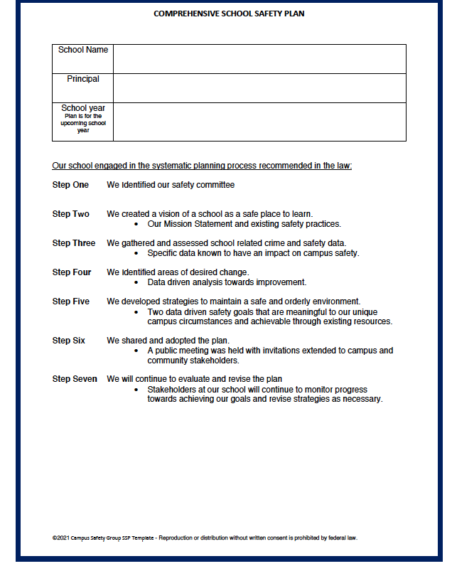
7 Step Planning Process
CSSP Process
Identify you team
Create school vision
Gather & analyze data
Identify areas of change
Select/implement strategies - (Goals)
Share the plan - (Goals)
Evaluate and revise

Slide 15
Step 1 Team Requirements
Site Council or School Safety Planning Committee
Principal or designee
Teacher and classified employee who are a representative of recognized certificated employee organization
A parent whose child attends the school
Law enforcement, fire agency and other first responders must be consulted in the writing and development of CSSP (District Liaison)
Other members, if desired
Student representative of each grade level as age appropriate
Stakeholders-community partners, business, non-profits
Notes:
Student representative of each grade level should attend as age appropriate; student voice is a critical component of success as they have knowledge about the safety and climate of the campus and are better able to get their peers to be actively engaged
Community liaison for person(s) with limited English proficiency
Specialist for person(s) with visual or hearing impairment
County and local mental health professionals
Community and business members
Juvenile justice system representatives
Faith-based organizations
Social services, child protection services, foster care; homelessness advocate
Person(s) with disabilities and special needs
Health services, substance-abuse services
Multilingual media outlets
Vocational services, career education
Parks and recreation department, athletic organizations
Before and after-school programs
Community organizations
Vocational services, career education personnel
Parks and recreation department, athletic organizations
Senior citizen groups
Colleges and universities representative
Military installations
School psychologist, school counselor, athletic coaches, school based mental health, school nurse, campus supervisor, information technology (IT) staff, and facilities staff

Slide 16
Step 2 Create a Vison of a School as a Safe Place to Learn
Students thrive in environments where they feel safe, nurtured and respected
What does Team want the school to look like?
Does schools mission statement make a reference to student safety
What is the vision of a school that is a safe place to learn?
What are the current initiatives, programs, frameworks designed to improve safety, climate
Notes:
According to the U.S. Department of Education and the U.S. Department of Justice Office of Justice Programs, between 2001 and 2017, the percentage of students ages 12 to 18 who reported being afraid of an attack or harm at school decreased from 6 percent to 4 percent and the percentage who reported being afraid of an attack or harm away from school decreased from 5 percent to 3 percent.
In 2017, about 6 percent of students ages 12 to 18 reported avoiding school activities or classes during the previous school year because they thought someone might attack or harm them. In 2015, 5 percent of students reported avoiding activities or classes, staying home from school. (Students who reported more than one type of avoidance of school activities or classes were counted only once in the total for avoiding activities or classes. Students who reported avoiding multiple places in school were counted only once in the total for students avoiding one or more places.)

Slide 17
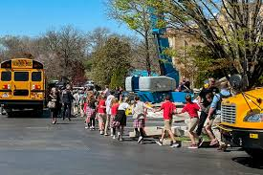
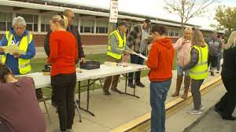
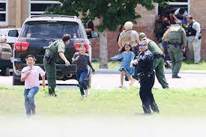
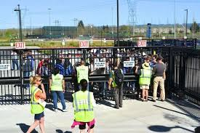
What Type Crisis Keeps You Awake at Night

Slide 18
Step 3 Gather and Analyze EC32282
Child Abuse reporting
Disaster procedures
Suspension & Expulsion Policies
Notify teachers of dangerous pupils (suspended)
Discrimination, Harassment, EC200+ (FAPE)
Dress code-maybe N/A
Safe ingress/egress
Safe & orderly environment
Discipline rules
Tactical/Threat response
Bullying prevention*
Roles mental health & law enforcement*
Toxic substance ¼ mile*
Sex abuse and sex trafficking prevention*
Opioid Overdose 7-12
*Recommended
Notes:
Child abuse prevention and reporting BP 5141.4
Emergencies and disaster preparedness plan BP 3516
Emergency drills BP 3516.1
Earthquake emergency procedure system BP 3516.3
Suspension and expulsion/due process BP 5144, 5144.1, 5144.2
Teacher notification of dangerous students BP 4158.1
Hate motivated behavior BP 5145.9
Nondiscrimination/harassment, hate crimes AR 5145.3
Sexual Harassment BP 5145.7
Dress and grooming BP 5132
Gangs BP 5136
Discipline BP 5144
Student disturbances BP 5131.4
Tactical responses to criminal incidents plan EC 32281
Tactical response, governing board discuss in closed session GC 54957
Tactical response, documents that asses and plans confidentiality GC 6254(aa)
Bullying BP 5131.2
Mental health professionals, counselors, SRO roles EC 32282.1
Toxic substance or pesticide release response procedures EC 32284
Sex abuse, trafficking prevention EC 49380

Slide 19
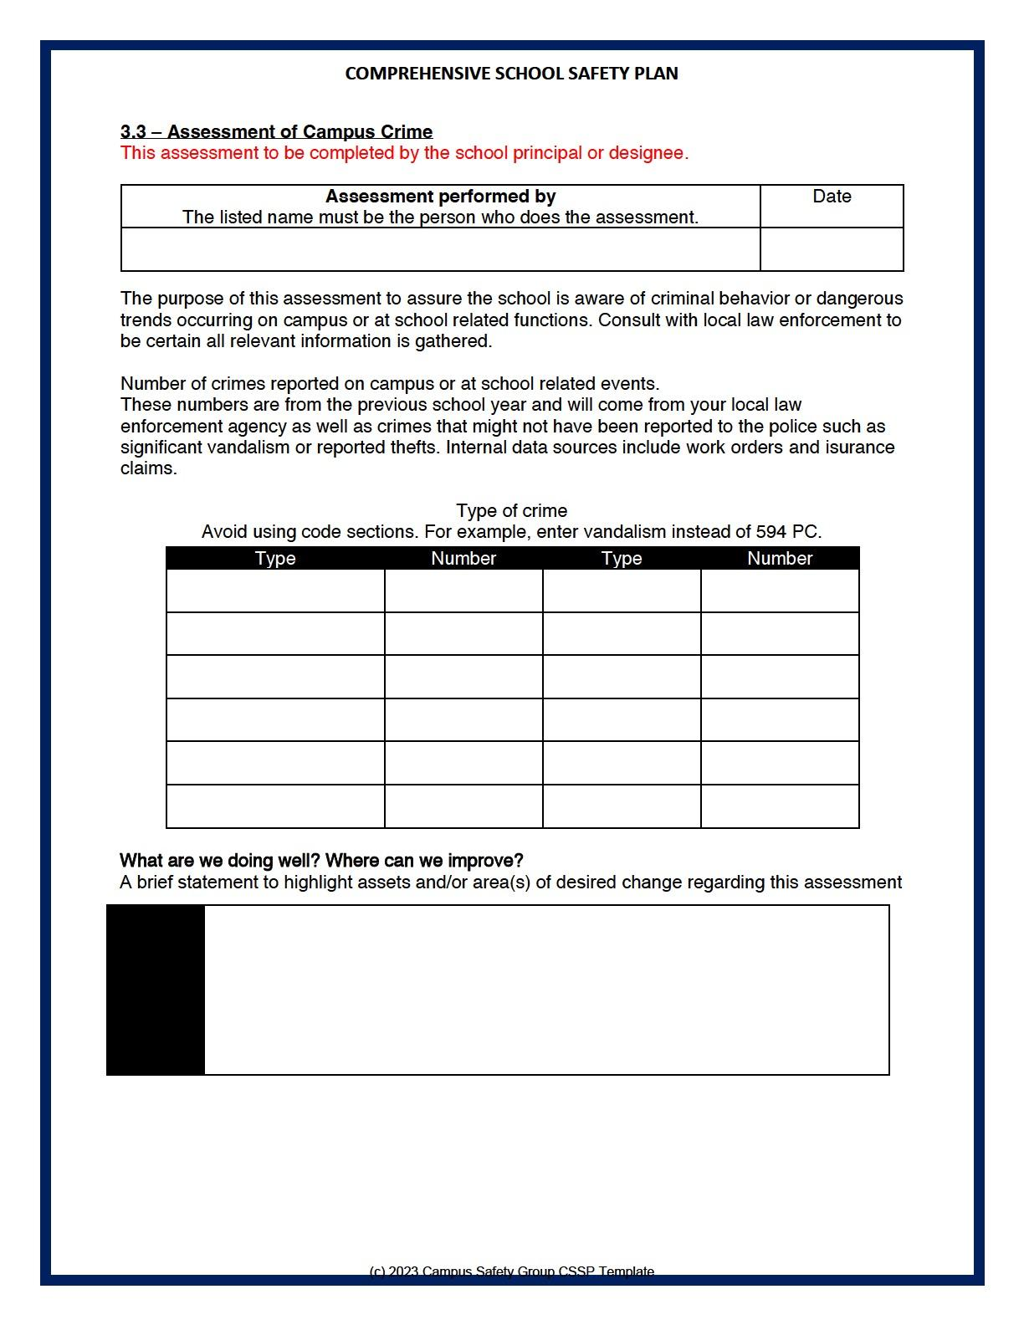
Asses School Related Crime
Different ways to define school crime, ranging from considering any threat or theft as a crime, to considering only violent attacks
Sources include/but not limited to:
Police reports
Google crime mapping
Insurance claims
Office referrals
California Healthy Kids Survey
California Dashboard data
Student, staff, parent, stakeholder surveys

Slide 20
Disaster Procedures
All schools will encounter a natural disaster or emergency situation that requires immediate response
Identify potential and inherent hazards, earthquakes, man-made disasters, traffic accidents, etc.
Responding will be easier if school has a plan that is known and has been practiced regularly by all
School districts have a responsibility to be as prepared as possible to meet emergencies

Slide 21
Plans
As many types of incidents as applicable, (with ADA adaptions SB323-1/1/24 - IEP-process), including but not limited to:
Fire, Earthquake
Intruder/active violent incidents, active shooter, hostage
Bomb threats
Bioterrorism/hazardous materials
Flood-including water main breaks, fire sprinkler breaks
Power failure, blackouts; planned power outages
Explosions, gas leaks, gas odor
Pandemic outbreaks
Civil disturbances such as protests and riots

Slide 22
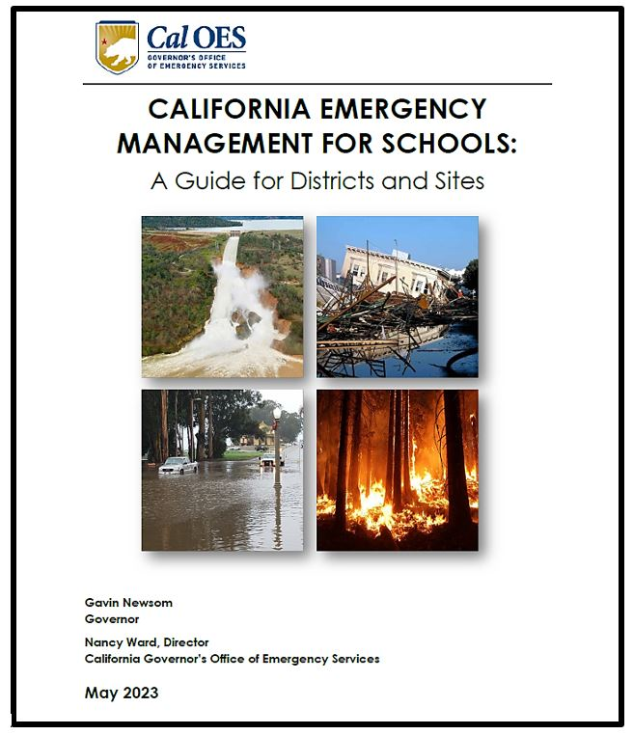
Disaster Plan
Include General Plan Framework / Procedures
Incident Command -trained
Maps, including shut-off locations
Disaster supplies, site and classroom
Team selection, assignments
Medical Team procedures
First aide, CPR trained, supplies
Search and Rescue procedures
Reunification Team procedures
Administrator?

Slide 23
Standardized Emergency Management System (SEMS) ICS 100 & NIMS 700 Incident Command
Number of required courses increases with level of position responsibility | PERSONNEL Includes Federal/State/Local/Private Sector and non-Governmental Personnel | REQUIRED TRAINING Courses listed below in BOLD ITALICS currently required for NIMS Compliance
ICS 100/IS 700 SEMS (Responders) Best Practice for all Staff, including Teachers and Classified Staff | ENTRY LEVEL RESPONDERS & DISASTER WORKERS Emergency Medical Service, firefighting, law enforcement, hospital, public health, public works/utility, skilled support and other emergency management response, support & volunteer personnel at all levels | FEMA IS 700a: NIMS, An Introduction ICS-100: Introduction to ICS or equivalent Introduction to SEMS
ICS 200 SEMS EOC (Supervisors) Best Practice for all Administrators | FIRST LINE SUPERVISORS Single resource leaders, field supervisors, and other emergency management/response personnel that require a higher level of NIMS training | FEMA IS 700a: NIMS, An Introduction ICS-100: Introduction to ICS or equivalent ICS-200: Basic ICS or equivalent SEMS EOC/ Introduction to SEMS
ICS 300/IS 800 SEMS EOC (Managers) Best Practice for District and school level emergency management | MIDDLE MANAGEMENT Strike team leaders, task force leaders, unit leaders, division/group supervisors, branch directors, and multi-agency coordination center / emergency operations center staff | FEMA IS 700a: NIMS, An Introduction FEMA IS 800 b: National Response Framework (NRF) ICS 100: Introduction to ICS or equivalent ICS 200: Basic ICS or Equivalent ICS 300: Intermediate ICS or equivalent SEMS EOC/Introduction to SEMS
ICS 400 (Command) Six Months after ICS 300 Completion Best Practice for a District level emergency management person | COMMAND AND GENERAL STAFF Department heads with Multi-agency coordination system responsibilities, area commanders, emergency managers, multi-agency coordination center/emergency operations center managers | FEMA IS 700a: NIMS, An Introduction FEMA IS 800b: National Response Framework (NRF) ICS 100: Introduction to ICS or equivalent ICS 200: Basic ICS or Equivalent ICS 300: Intermediate ICS or equivalent ICS 400: Advanced ICS or equivalent SEMS EOC/ Introduction to SEMS
Notes:
See handout
ICS 100 & NIMS 700

Slide 24
Training
CAOES Approved SEMS training courses-SEMS
https://csti-ca.csod.com/catalog/CustomPage.aspx?id=20000553&tab_page_id=20000553&tab_id=20000590
National Incident Management System, NIMS required courses for specific level of positions
https://www.caloes.ca.gov/PlanningPreparednessSite/Documents/02%20NIMS%20Cal%20OES%20Compliant%20Training%20Reference%20Chart%206-12.pdf
Notes:
California Governor’s Office of Emergency Services California Specialized Training Institute website: https://csti-ca.csod.com/catalog/CustomPage.aspx?id=20000553&tab_page_id=20000553&tab_id=20000590
The National Incident Management System, NIMS has a list of required courses for specific level of positions https://www.caloes.ca.gov/PlanningPreparednessSite/Documents/02%20NIMS%20Cal%20OES%20Compliant%20Training%20Reference%20Chart%206-12.pdf

Slide 25
Procedure – Use by Public Agency
Establish procedures to allow public agency to use school buildings, grounds, & equipment for mass care & shelter during emergency
(FEMA)Disaster and Emergency Resources: https://www.ready.gov/be-informed
CA Office of Emergency Services - emergency supply list for schools: https://www.rems.ed.gov/docs/SchoolEmergencySuppliesList.pdf

Slide 26
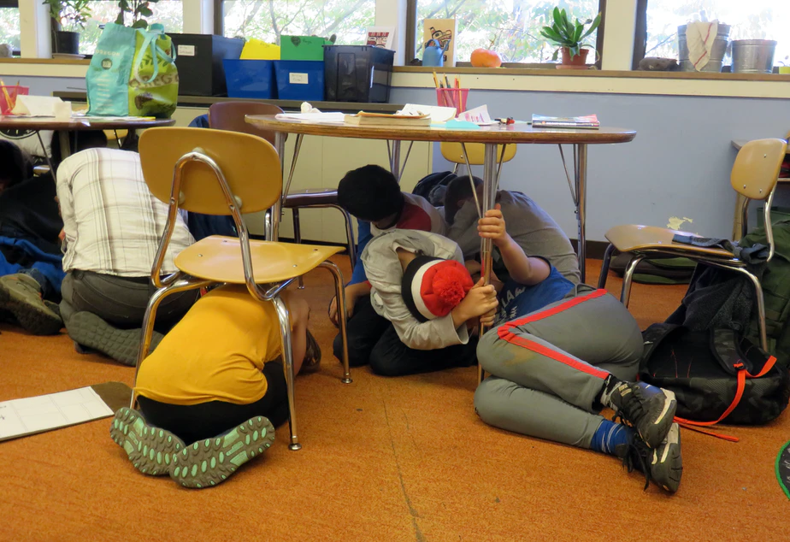
Required Drills
Fire Drills - EC 32001
Fire alarm system which shall be tested at least once every calendar month
Elementary – 1x/month
Intermediate – 4x every school year
Secondary – 2x every school year
Drop Procedure (Earthquake) – EC 35297
Elementary – 1x/Quarter
Secondary – 1x/Semester
Review?
Notes:
32001 the fire alarm signal to be sounded not less than once every calendar month and shall conduct a fire drill at least once every calendar month at the elementary level and at least four times every school year at the intermediate levels.
A fire drill shall be held at the secondary level not less than twice every school year.
35297 (b) A drop procedure. As used in this article, “drop procedure” means an activity whereby each student and staff member takes cover under a table or desk, dropping to his or her knees, with the head protected by the arms, and the back to the windows. A drop procedure practice shall be held at least once each school quarter in elementary schools and at least once a semester in secondary schools.
32001 Every public, private, or parochial school building having an occupant capacity of 50 or more pupils or students or more than one classroom shall be provided with a dependable and operative fire alarm system. Every person and public officer managing, controlling, or in charge of any public, private, or parochial school shall cause the fire alarm signal to be sounded upon the discovery of fire, unless the school is equipped with an automatic fire detection, and alarm system, which may include, but for the purposes of this section is not required to include, a sprinkler system, as described in Section 17074.52. Every person and public officer managing, controlling, or in charge of any public, private, or parochial school, other than a two-year community college, shall cause the fire alarm signal to be sounded not less than once every calendar month and shall conduct a fire drill at least once every calendar month at the elementary level and at least four times every school year at the intermediate levels.
A fire drill shall be held at the secondary level not less than twice every school year.

Slide 27
Notifying Teachers of Dangerous Pupils
TITLE IS MISLEADING!
Based on records district maintains, or receives from a law enforcement agency
Behavior during current and three previous three school years
except possession of tobacco
Any information received by a teacher is confidential and shall not be disseminated by teacher
Violent crime notifications to families - voluntary
Notes:
EC 32282D, 49079, Welfare and Institution Code (W&I) 827(b))
49079 (a) A school district shall inform the teacher of each pupil who has engaged in, or is reasonably suspected to have engaged in, any of the acts described in any of the subdivisions, except subdivision (h), of Section 48900 or in Section 48900.2, 48900.3, 48900.4, or 48900.7 that the pupil engaged in, or is reasonably suspected to have engaged in, those acts. The district shall provide the information to the teacher based upon any records that the district maintains in its ordinary course of business, or receives from a law enforcement agency, regarding a pupil described in this section.

Slide 28
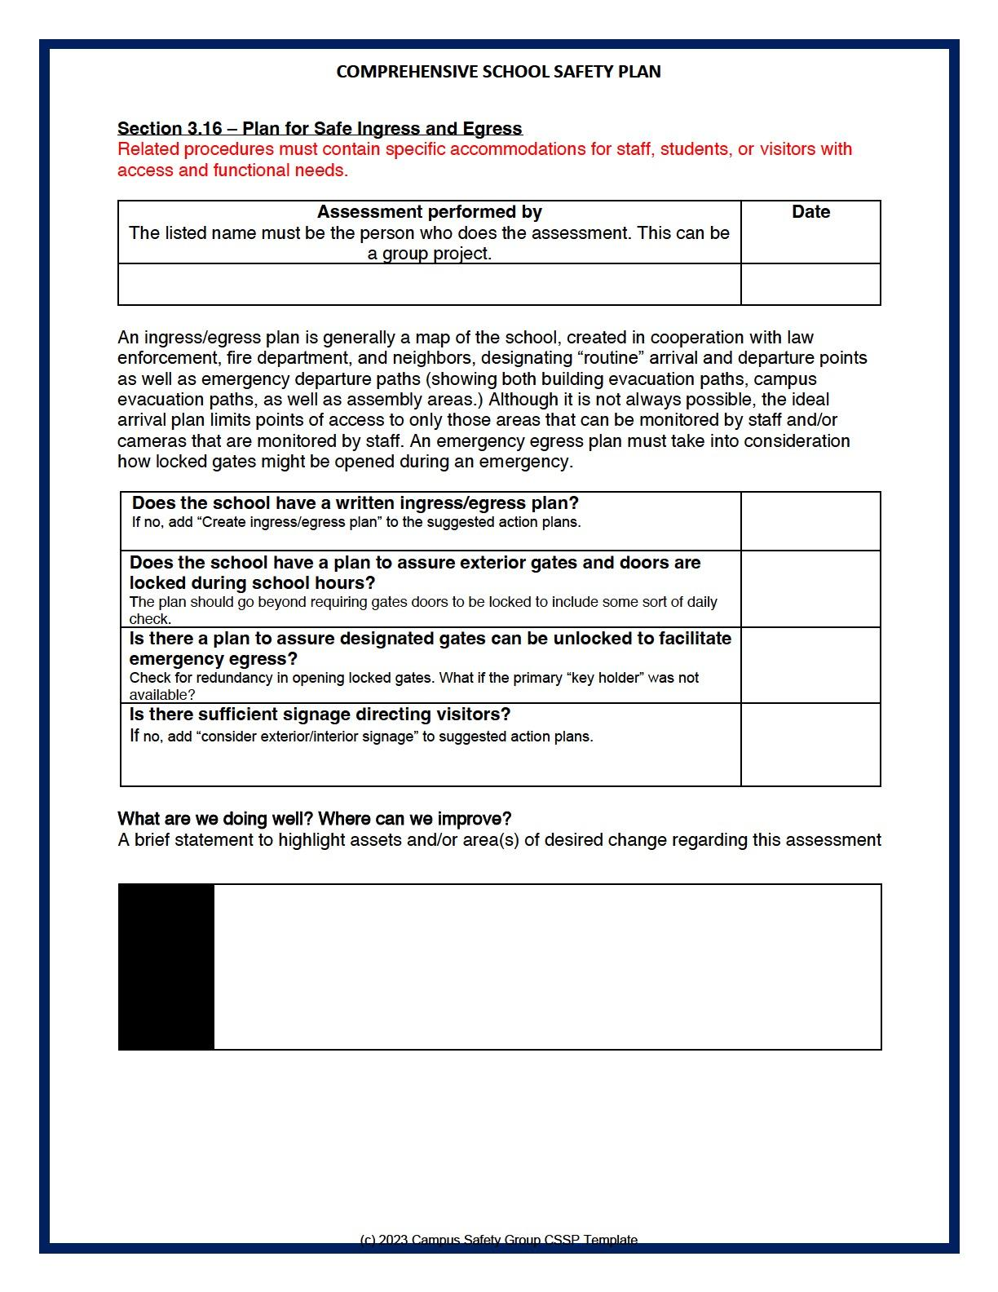
Safe Ingress & Egress
Visitors Policies (report unidentified / intruders)
Traffic Safety, Crossing Guard Programs
Site Emergencies
Specific and alternative routes and assembly areas
ADA and outside of school hours
Hardware on doors/gates provide for security-evacuation
Signage

Slide 29
Tactical Response to Criminal Incidents
Steps taken to safeguard pupils and staff, secure site, and apprehend perpetrator(s)
Lockdown/evacuation
Coordinate with PD/FD
Training/table-top - Age appropriate
Not required to disclose - can discuss in closed session with law enforcement
Exempt from disclosure - CA Public Records Act, GC 6254 (aa)

Slide 30
SB671-Threatened Unlawful Activity
Procedures to respond to threatened or active reports of dangerous, violent or unlawful activity at school, school activity or school bus
Effective January 1, 2024

Slide 31
Bullying Prevention
Lawsuits
AB 2291 - by December 31, 2019
Procedures to prevent bullying and cyberbullying
Training all employees – HR, faculty meetings
Data reviewed – two years
Intradistrict and Interdistrict transfer permit for bullied student
CDE Online Bullying Prevention Training Program https://www.cde.ca.gov/ls/ss/se/bullyres.asp
Notes:
Examples of successful lawsuits include:
Walsh v. Tehachapi Unified School District in 2014, $750,000 settlement
Shimizu v. Folsom Cordova Unified Sch. District in 2014, $1,000,000 settlement
Doe v. Roe School District in 2012, $1,350,000 settlement.
According to California Assembly Bill 34 (2019), approximately 28 percent of pupils in grades 6 through 12, have experienced bullying and 70 percent have witnessed bullying. While nearly 14 percent of pupils have experienced cyberbullying, 55 percent of LGBTQ pupils have reported being cyberbullied.

Slide 32
Roles Mental Health & Law Enforcement
Encouraged to include
School counselors, intervention professionals
Law Enforcement, SROs (not disciplinarian)
Create and maintain a positive school climate
Prioritize mental health and intervention services
Restorative justice programs
PBIS
Notes:
20 percent of students in kindergarten through twelfth grade suffer from a mental health issue that affects their relationships at school, home, and in the community. Many of these students do not seek assistance; they suffer silently, become alienated, and may contemplate suicide.

Slide 33
SB10-Responding to student Opioid Overdose
Schools with grades 7 to 12
Develop a protocol in the event a pupil is suffering or is reasonably believed to be suffering from an opioid overdose
COE and local health agencies
CDE to provide resources
Legislative intent – use alternatives to a referral to law enforcement agency for opioid use
Effective January 1, 2024
Notes:
Governing boards that have schools with grades 6 to 12 must identify methods of informing parents/guardians of pupils in those grades of human trafficking prevention resources.
Sex trafficking is defined by the amended Trafficking Victims Protection Act of 2000 as “The recruitment, harboring, transportation, provision, obtaining, patronizing, or soliciting of a person for the purpose of a commercial sex act.” Sex trafficking occurs when an individual is exploited with force, fraud, or coercion of perceived sense of protection, isolation, shaming, and debt, to make them perform commercial sexual activity. Any commercial sexual activity with a minor, even without force, fraud, or coercion, is considered trafficking. Consequences of sexual violence, including sex trafficking, can be immediate and long term, including physical and relationship problems, psychological concerns, and chronic health outcomes.

Slide 34
Step 4 Identify Areas of Change
Based on data, strengths/weaknesses
Climate
High risk locations, hallways, bathrooms
To and from home, ingress/egress
Disaster plan, drills, supplies
Gaps in vision/practices/procedures?
Physical environment improvements to create safer school - Crime Prevention Through Environmental Design (CPTED)

Slide 35
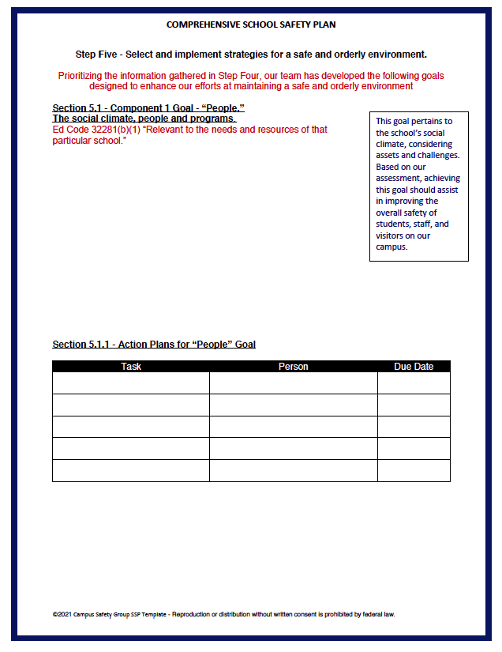
Step 5 Strategies for a Safe & Orderly Environment Goals
Existing Resources
One Social - “People”
One Physical – “Place”
Measurable / Data-based
Action plans with specific timelines and person responsible
Site and/or district goals

Slide 36
Component 1 The Social climate - People and Programs
Social Climate = relationships
Climate is everyone's responsibility
Students need to believe the school is a caring community where they can express themselves
Staff need to feel appreciated, that they make a difference, and are safe
Types of Goals
Prevention/Intervention
Programs that involve collaboration with other agencies/community

Slide 37
Component 2 The Physical Environment- Place
CPTED (Crime Prevention Through Environmental Design) https://www.rems.ed.gov/docs/CDC_CPTEDSchoolAssessment.pdf
Responses to critical incidents
Window coverings, or adhesive film
Staff, other than security, supervising hallway
Repair school quickly, remove vandalism
Visitors to sign in and wear visitor badges or stickers
Disaster preparedness
Notes:
Design includes walls that reduce sight lines for active shooters in hallways/classrooms
Provide adequate lighting and eliminate dark hiding places
Closing campus and locking entrance doors during school day
Camera with audio allows staff to communicate with visitors, delivery personnel

Slide 38
Step 6 Ensure Compliance
Prior to adoption - share plan at public meeting
Written invites to:
Local Mayor
Site classified and certificated organization
Each parent group on campus
Student body government
Persons who want to be notified
Churches, civic leaders, businesses

Slide 39
Share & Adopt Considerations
Provide a copy of “social” and “physical” goals
Discuss planning process
SSC convenes and votes to “adopt”
Plan available for public inspection
Tactical plans – confidential

Slide 40
Planning Due Dates
Adopted by March 1 (what school year?)
Approved by school district or COE-date?
Notify CDE of non-compliance by October 15
Part of SARC, July
Annual fiscal audit, December 15
Plan available for public inspection
i.e. office and/or website
Tactical plans – confidential
Revise as needed-notify 1st responders

Slide 41
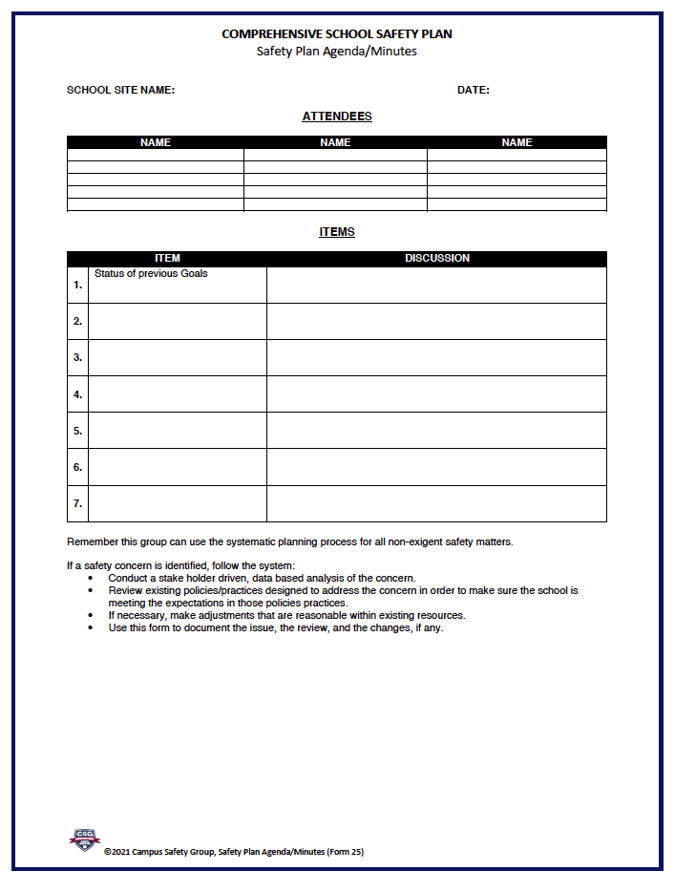
Step 7 Evaluate and Revise
What school year is plan developed - current or future?
All staff trained on plan
SSC agenda-every meeting
Are tasks being accomplished?
Are measures being met?
Revise as needed-notify 1st responders
Safety is a continual process!

Slide 42
Template
No required format, compliance tools
Include all components
Documentation of implementation
Review of district’s board policies and procedures for complying with existing laws related to school safety

Slide 43
Campus Safety Group A Non-Profit
Campus Safety Group provides training based on the Guide that includes a fillable PDF compliance template
Assist schools in updating their procedures to establish a sustainable CSSP process
Compliance project cost for up to 9 schools, $4995
Compliance Review
Free for attendees of this class!
Email your last CSSP to below address
www.campussafetygroup.org
E-mail: toms@campussafetygroup.com
Tom Steele cell (818)203-8969

Slide 44
https://www.google.com/search?q=valentine%27s+day+10+minute+timer&rlz=1C1GCEA_enUS1056US1056&oq=valentine%27s+day+10+minute+timer&gs_lcrp=EgZjaHJvbWUyBggAEEUYOTIKCAEQABgKGBYYHjIICAIQABgWGB4yDQgDEAAYhgMYgAQYigUyDQgEEAAYhgMYgAQYigUyDQgFEAAYhgMYgAQYigXSAQg3MDM5ajBqN6gCALACAA&sourceid=chrome&ie=UTF-8#fpstate=ive&vld=cid:a6ef7747,vid:dbsbld14Hfc,st:0

Slide 45
Real Life School Safety Incident Response
Panel & Presentation
Dr. Gary McGuire
Moderator
Co-Presenter
Question Facilitator

Slide 46
Real Life School Safety Incident Response
Panel & Presentation
Tim Walker,
Deputy Superintendent of
Riverside Unified School District
Andrew Flores,
Director, Office of Emergency Management, University of California, Riverside
Dr. Gary McGuire,
Retired Director of Pupil Services,
Riverside Unified School District

Slide 47
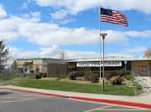
Incident Response
Castle View Elementary School
Riverside Unified School District
Campus Hostage Situation
October 31, 2017

Slide 48
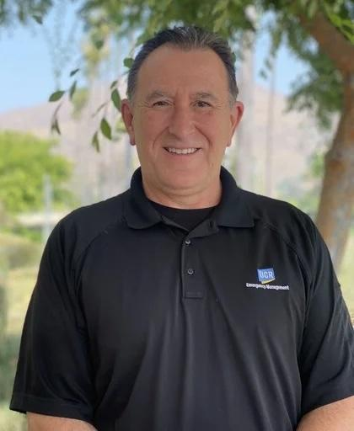
Panel Members
Tim Walker
Deputy Superintendent
Riverside Unified School District
Gary McGuire, Ed. D.
Director, Pupil Services – Retired
Riverside Unified School District
Andy Flores
Director, Office of Emergency Management
University of California, Riverside

Slide 49
Castle View Strong
https://youtu.be/gArq7ddWmWk?si=gOFoMO_ESkJS092n

Slide 50
Overview of Incident
Tuesday, October 31, 2017 @11:00 a.m.
Father of Castle View 1st Grader comes into office agitated & loudly demanding to see his daughter out of school (restraining order in place?)
Father’s mother had called school warning that he was coming to school and not to release girl to him
Principal called
Father gets more enraged, refusing to wait, exits office onto campus
Lock-down initiated/emergency contacts (RPD & District) called
Primary grades are at lunch in MPR
Principal attempts to stop father
Father sees daughter’s 1st grade teacher and grabs her
Substitute attempts to free teacher and is assaulted by father
Father drags teacher into her classroom, barricading the door: 6-hour long hostage situation begins

Slide 51
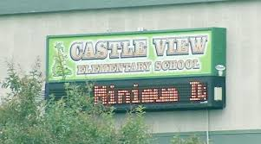
Before the Incident
Emergency Response Plans in Place
Updated Board Policy & Rules/Regulations
Agreements/MOUs with Police, Sheriff, & Fire Departments
Campus Security Staffing
Emergency Response Protocol with Mandated Annual Training & Drills
School Site Safety Structures
Notes:
Emergency Response Plans
Safe Schools Plans (requirements revised BP0450 Sept. 2016)
Including active shooter/intruder, evacuation, etc.
District Safety/Emergency Response Plan w/NIMS structure
Departmental responsibilities outlined
Emergency Communication Protocols
District 911 Communication Flow-chart (all 911 calls routed to Pupil Services)
RPD Contact information
Updated Board Policy & Rules/Regulations
Revised June 2017 BP1250 Visitors/Outsiders
Agreements/MOUs with Police, Sheriff, & Fire Departments
SRO & School Emergency Response Priority Agreements
Campus Security Staffing
SROs & Campus Supervisors
Emergency Response Protocol with Mandated Annual Training & Drills
Active Shooter Training/Drills – annual requirements (A.L.I.C.E. & SRO trainings)
All staff and students

Slide 52
Before the Incident
School Site Safety Structures
Relationships with RPD, RSD, and RFD
District Crisis Response team in place
Strong District inter-departmental communication & collaboration
Notes:
School site safety Structures
Single point of entrance (all external gates & doors locked)
Classroom doors locked with lock-blocks installed
Controlled and supervised points of student egress/regress
District radio & cell phone communications
SIS cloud based, evacuation box with emergency contacts
Relationships with RPD, RSD, and RFD
Quarterly Pupil Services meetings with SROs and RPD leadership
District Crisis Response team in place
Strong District inter-departmental communication & collaboration
Riverside Police Department
Internal preparation: training, procedures, expectations
University of Redlands & UCR
Preparation, training, & procedures

Slide 53
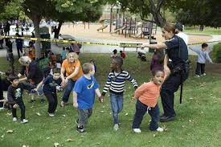
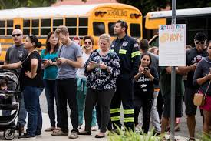
During Incident
Uniform Command Structure Established
Campus Secured & Student/Staff Safety Verified
Information flow
Campus & Evacuation Logistics
Food & Water for Command team & emergency personnel on campus
Evacuation Transportation
Evacuation/Re-unification location & Student Safety/Well-Being Logistics
Notes:
Uniform Command Structure Established: District & RPD perspectives
RPD takes the lead
District Incident Commander: Tim Walker
District Liaison: Gary McGuire
Communication: RPD & District PIOs
Campus Secured & Student/Staff Safety Verified
Incident Command location set up
Containment of suspect and hostage in the barricaded classroom
Controlled evacuation of students to nearby park
Neighborhood perimeter set-up to keep media & non-incident individuals out
Information flow
Direct Dial & Social Media communication with parents/community
Coordinated press releases
Campus & Evacuation Logistics
Building & classroom access points (school map, blueprints, floor plans)
Door access/keys
Control of communication lines (radio, internet, phones)
Access to wifi for 1st responders
Ongoing communication with Pupil Services Team from District Command
Pupil Services team coordinates all activity at evacuation site
Food & Water for Command team & emergency personnel on campus
Evacuation Transportation
Evacuation/Re-unification location & Student Safety/Well-Being Logistics
Food, water, porta-potties, easy-ups
District administrative & support staff – supervision, re-unification
Counseling staff on site to support students & staff
Data hot spots, phone rechargers, extra radios and/or radio batteries
Police & Sheriff assist with containment of evacuation location

Slide 54
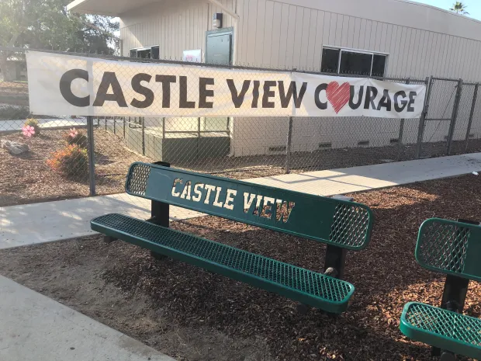
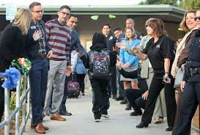
After Incident
Post-Incident Mapping & Planning
Communications
School Level Logistics
Students, Staff, Community, Facilities
School Closure & Re-Opening
After-Action Review
Notes:
Post-Incident Mapping & Planning for School Closure & Re-opening
Community meeting
Press releases
Student/staff personal property pick-up/cars etc
School closed for rest of week to clean up site/classroom closed rest of year
HR - counseling for staff at site and those involved directly with incident response available for @month after for district staff Applying to CDE for waiver of daily instructional minutes Extra-campus supervisor provided for remainder of year Re-opening: PD presence & feeder school welcoming students CV teddy bears for students Pupil Services staff presence at re-opening and several days after that SAP counselor presence
Communication with/support of student and family of the hostage taker Parent/community meetings following incident After action review*
Positives
Deltas
Next time
School Safety Assessments
Visitor Management System – RAPTOR: screening & alerts
Review of campus access – doors, locks, gates

Slide 55
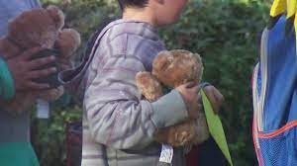
TOP TEN TAKEAWAYS FROM CASTLE VIEW From After Action Review
Accounting for all students, before releasing any students to parents;
Radios communications might not work in all locations, be prepared to use cell phones if needed
Picture IDs for all Staff/Identification of some kind when staff at evacuation site
Attendance rosters printed once a month and put with Emergency cards
Police Department support at park
Teachers following intruder/active shooter procedures key
Predetermined potential evacuation sites in place
Extra master key for emergency responders
Coordination/procedures to keep students together by class and grade for reunification purposes
Mobile evacuation supplies
Notes:
TOP TEN TAKEAWAYS FROM CASTLE VIEW
From After Action Review
Accounting for all students, before releasing any students to parents;
Radios communications might not work in all locations, be prepared to use cell phones if needed
Picture IDs for all Staff/Identification of some kind when staff at evacuation site
Attendance rosters printed once a month and put with Emergency cards
Police Department support at park
Teachers following intruder/active shooter procedures key
Predetermined potential evacuation sites in place
Extra master key for emergency responders
Coordination/procedures to keep students together by class and grade for reunification purposes
Mobile evacuation supplies

Slide 56
Questions & Thoughts

Slide 57
Handouts/Resources
FEMA NIMS Flow-chart with Training Links
Castle View Incident Timeline
Community Meeting Safety Talking Points
Emergency Communication Flow-Chart
Protocol Procedures in a 911 Emergency
Emergency Protocol

Slide 58
Are you a member of the California Association of Supervisors of Child Welfare and Attendance
also known as CASCWA?
CASCWA is here for YOU!
Notes:
Hello.
Thank you Vincente and thank you LACOE for all of your work to continue to host this excellent annual event.
I’d like to extend an enthusiastic and warm invitation to you all to join CASCWA if you are not yet a member. We ARE here for YOU!
As noted on the 2nd slide — We have many supports for school districts in general and for our CWA friends in particular. CASCWA was a life saver for me throughout my years in Student Services…particularly my first year when I was first learning my new role.
Please feel free to reach out to me if you have questions–my information is on the third slide for your convenience.
Thank you!

Slide 59
Available Experts in Child Welfare & Attendance
Up-to-Date Information on current issues, trends and findings
Connections & Networking throughout California for all district staff and CWA Administrators and CWA staff in particular
In-person and Virtual Workshops available throughout the year
Annual State Conference with a plethora of resources for you to be at your best when addressing Attendance, Ed. Code, Restorative Practices, current trends, etc.
Receive ongoing legislative updates related to CWA issues

Slide 60
How to become a CASCWA Member
Click on this link or the scan the
QR Code
Please reach out to the
CASCWA Southern Section Membership Chair
for questions regarding available services/workshops and membership.
WE WANT YOU WITH US!

Slide 61
EVALUATION
All of the participants who complete the evaluation by Monday 2/12 @ 12pm will be entered into a raffle for a $100 Amazon e-gift card. Winner to be announced Monday afternoon via email.
2024 Phil Kauble Evaluation for Attendees

Slide 62
CASCWA WEBSITE
Check-out the CASCWA Website at
http://cascwa.wildapricot.org/

Slide 63
Educator’s Guide to Comprehensive School Safety Plans (2023-24 Edition)
Campus Safety Group is incredibly proud to have been exclusively selected to write the “Educator’s Guide to Comprehensive School Safety Plans, 2023-2024 Edition”. This was a joint project between The Department of Education, the Department of Justice, the Los Angeles County Office of Education, as well as several other stakeholder agencies.
The 2023-2024 Guide to School Safety Plans is an essential first step towards compliance, however, LEA’s will still need training and support to assure they establish and maintain a “culture of compliance” with all safety mandates.
Ordering information:
Email - Elizabeth Iniguez at Iniguez_Elizabeth@lacoe.edu
Notes:
DOJ = California Department of Justice
OES = California Governor’s Office of Emergency Services
The updated edition addresses pandemic response, tactical response, mental health intervention, and methods to improve school climate and physical safety
The guide explains how to ensure compliance with CSSP regulations, and provides templates and resources.

Slide 64
ANNUAL SCHOLARSHIP!
Notes:
DOJ = California Department of Justice
OES = California Governor’s Office of Emergency Services
The updated edition addresses pandemic response, tactical response, mental health intervention, and methods to improve school climate and physical safety
The guide explains how to ensure compliance with CSSP regulations, and provides templates and resources.

Slide 65
THANK YOU FOR JOINING US TODAY!
Southern Section

