Slide 1
Are you a member of the California Association of Supervisors of Child Welfare and Attendance
also known as CASCWA?
CASCWA is here for YOU!
Notes:
Hello.
Thank you LACOE for all of your work to continue to host this excellent annual event.
I’d like to extend an enthusiastic and warm invitation to you all to join CASCWA if you are not yet a member. We ARE here for YOU!

Slide 2
Available Experts in Child Welfare & Attendance
Up-to-Date Information on current issues, trends and findings
Connections & Networking throughout California for all district staff and CWA Administrators and CWA staff in particular
In-person and Virtual Workshops available throughout the year
Annual State Conference with a plethora of resources for you to be at your best when addressing Attendance, Ed. Code, Restorative Practices, current trends, etc.
Receive ongoing legislative updates related to CWA issues
Notes:
As noted here — We have many supports for school districts in general and for our CWA friends in particular. CASCWA was a life saver for me throughout my years in Student Services…particularly my first year when I was first learning my new role.

Slide 3
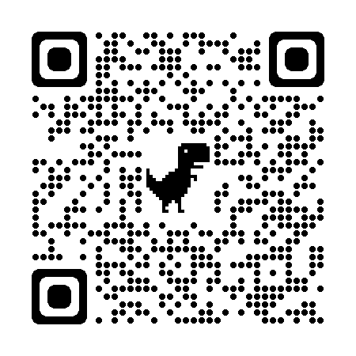
How to become a CASCWA Member
Click on this link https://cascwa.wildapricot.org/To-Join or the scan the
QR Code
Please reach out to Aurora Mendoza Perry,
CASCWA Southern Section Membership Chair
for questions regarding available services/workshops and membership.
aurora.mendoza.perry@gmail.com
WE WANT YOU WITH US!
Notes:
Please feel free to reach out to me if you have questions–my information is on the third slide for your convenience.
Thank you!
CASCWA Membership LACOE 12.9.2022 2022-2023

